Slide 1
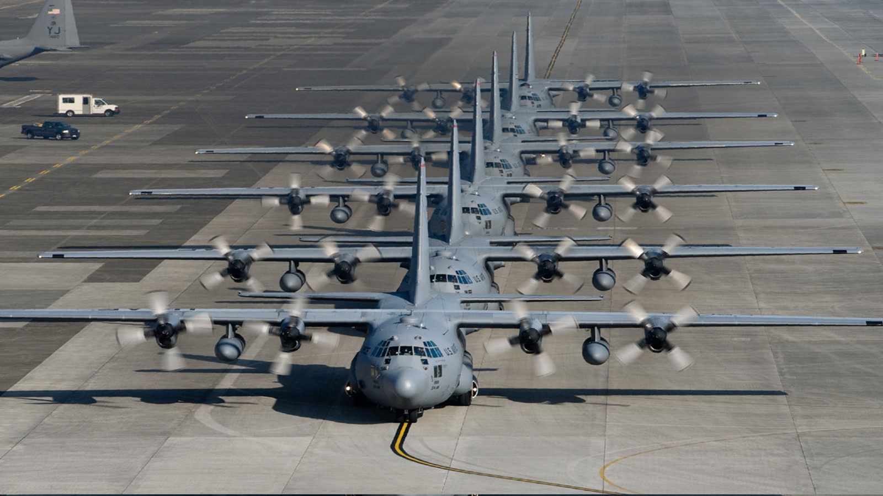
CUI// SP-CTI / SP-EXPT
Mobility Air Forces (MAF)
Distributed Mission Operations (DMO)
Program Management Review
Mission Technologies
A division of HII
FA8621-15-D-6268/FA8621-22-F-6268
Date: 5 February 2025 (Day 1)
John “Shack” Shackelford
MAF DMO PM
Controlled by: MAF DMO
Controlled by: AFLCMC/WNS
CUI Category(ies): CTI, EXPT
Distribution Statement: D
POC: John Shackelford
407-737-3599 Ext. 527
CUI// SP-CTI / SP-EXPT
Notes:
POC: Shack
Briefer: Shack

Slide 2

Mobility Air Forces (MAF)
Distributed Mission Operations (DMO)
DISTRIBUTION STATEMENT D:
Distribution authorized to the Department of Defense (DoD) and U.S. DoD Contractors only: in accordance with Contract FA8621-15-D-6268/Delivery Order FA8621-22-F-6268, 1 July 2022. Other requests must be referred to the USAF Simulators Division, AFLCMC/WNS MAF DMO Program, 2300 D Street, Bldg. 32, Wright Patterson AFB, OH 45433-7249
EXPORT CONTROL WARNING:
Warning: This document contains technical data whose export is restricted by the Arms Export Control Act (Title 22, U.S.C., Sec 2751, et seq.) or the Export Control Reform Act of 2018 (Title 50, U.S.C., Chapter 58, Sec. 4801-4852). Violations of these export laws are subject to severe criminal penalties. Disseminate in accordance with provisions of DoD Directive 5230.25 and DoD Instruction 2040.02.
DESTRUCTION NOTICE:
Destroy by any method that will prevent disclosure of contents or reconstruction of the document.
DISCLAMER STATEMENT:
Per AFLCMC/WNS & AFLCMC/WN direction, Rules of Engagement for MAF DMO meetings & telecons:
This is a reminder that no one in these discussions has the authority to direct the contractor to alter contract requirements or to modify in any way the legal responsibilities under the contract. Only the Contracting Officer has that authority.
If the US Air Force, as a result of these discussions, does desire to change any requirements under the contract, direction will be provided in writing, signed by the Contracting Officer.
No action should be taken on any perceived changes to current contractual requirements until written CO direction is provided.

Slide 3
Agenda Wednesday, 5 February 2025
(Day 1)
The Celeste Hotel, Orlando, a Tribute Portfolio Hotel (4105 N Alafaya Trl, Orlando, FL 32826)
Teams Meeting: Click here to join the meeting; Or call-in +1 757-716-0190, Phone Conference ID: 529 158 549#
0830 – 0845 EST: Introductions and Opening Remarks
0845 – 0900 EST: Program Management
  Program Timeline
  Meeting Schedule
  Travel
  Communications Security (COMSEC)
  Risk Management
0900 – 0950 EST: Distributed Training
Center (DTC)
  Event Management
  MAF Mission Profile (MMP) Review
  FVEY Coalition Training Support
  Training Cost Avoidance
  Metrics and Reporting Issues
0950 – 1005 EST: Systems Engineering
  Configuration & Data Management (CDRLs)
  Engineering Change Proposal/Contract Change Proposal
  GFE Accountability & PCAs
1005 – 1015 EST: Break
1015 – 1025 EST: Cybersecurity
  Status
  MAF DMO ATOs
1025 – 1105 EST: IT Services and Integrated Systems
  Upgrade and Modification
  Qualification and Test/TDIMs
  Software Tools Development
  Interoperability
  SCARS SMP
1105 – 1115 EST: V-VAR
1115 – 1150 EST: FVEYS Partner Connection Controlled Interface
1150 – 1200 EST: Action Item Review
1200 – 1330 EST: Lunch
1330 – 1500 EST: Side Bars
  DD-250 Discussion
  Top Secret / SCI DD-254 Discussion
  Form 1423 Block 8 Approval Status
1600 – 1700 EST: MAF DMO C-17 MMP Viewing

Slide 4
Introductions and Opening Remarks

Slide 5
MAF DMO Org Chart
John Scorsone
Director, MTS
Tampa, FL
Chris Schwindt
Solutions Architect
Orlando, FL
John Carswell
Solutions Architect
Daytona Beach, FL
MAF DMO Consultants / Special Projects
Christopher Nolan
FSO
Scott AFB, IL
Johnathon Shackelford
Program Manager
Orlando, FL
“Terri” Hutasewee
Program Control Analyst
Norfolk, VA
Theresa Starr
FSO
Orlando, IL
Shawn Hammack
Chief Engineer
Orlando, FL
Kaitlin Phan
Business Ops PM
Orlando, FL
Christi Taylor
Cybersecurity Engineer
Lead
Orlando, FL
Wayne Stilwell
Mission Engineering Lead
Orlando, FL
Richard Fraley
Software Engineering Lead
Orlando, FL
Anya Gustafson
Data Governance Lead
Orlando, FL
Arvo “Pyro” Sepp
DTC Site Manager
Scott AFB, IL
Chris Schejbal
IT Services Lead
Scott AFB, IL
Robert Russ
Integrated Systems Lead
Orlando, FL
Peggy Maddock
System Engineering Lead
Orlando, FL

Slide 6
Program Management

Slide 7
Program Timeline
Start of OY3
1 Mar
Firewall Refresh
Grissom KC-135
23-25 Jul
Firewall Refresh
132d CTS/DTOC
3-5 Dec
AMC/CC DTC Visit
18 Feb
MAF DMO PMR
24-25 Jul
TAC-F Testing
Tampa SIL
18-20 Sep
Firewall Refresh
Charlotte C-17
16-18 Oct
C-17 USAFWS Conference
24-26 Nov
TAC-F Testing
Tampa SIL
6-10 Jan
Bi-Lateral MMP 25-2
19-20 Feb
DTCN 1Yr ATO Renewal
12 Jul
Coalition Virtual Guardian 24-4
4-5 Sep
Tanker USAFWS Symposium
2-5 Oct
Site Survey
McConnel KC-46
12-14 Nov
Firewall Refresh
AFSOC
10-12 Dec
MAF DMO PMR
5-6 Feb
July 2024
August 2024
October 2024
November 2024
January 2025
February 2025
September 2024
December 2024
March 2025
Cert & Acceptance
Pittsburgh C-17
12-14 Feb
IAN 2Yr ATO Renewal
12 Jul
Firewall Refresh
Ramstein C-130
20-22 Aug
Firewall Refresh
Travis & March
29 Sep – 4 Oct
Airlift Tanker Association Conference
1-3 Nov
I/ITSEC 2024
2-6 Dec
Cert & Acceptance
Charlotte C-17
29-31 Jan
TAC-F Release
Early March
Firewall Refresh
Memphis & Jackson
6-8 Aug
Firewall Refresh
Fairchild KC-135
8-10 Oct
Firewall Refresh
Dyess C-130
19-21 Nov
Firewall Refresh
DMOC
17-19 Dec
Firewall Refresh
Charleston C-17
10-13 Feb
Start of OY3
1 Mar

Slide 8
Meeting Schedule: 60 Day Outlook
Meeting | Frequency | Dates | Day | Venue | Participants
Bi-Annual Program Management Review​​ | Every six months​​ | 5/6 Feb | Wed/Thurs​​ | Orlando, FL​​ | Gov, HII, CLS​​
MAF DMO Standards Working Group (MSWG) | Bi-Monthly | 6 Feb | Thurs | Teams | Gov, HII, CLS
C-130J Training Device Interchange Meeting (TDIM)​​ | Monthly​ | 6 Feb | Thurs​​ | Teams​ | Gov/HII/LMCO​​
Bi-Weekly SCARS Prime Integration Meeting | Every two weeks​ | 18 Feb | Tue | Teams​ | CAE, HII​, CLS
Bi-Weekly Program Status Review​​ | Every two weeks​​ | 18 Feb | Tue | Teams​​ | Gov, HII​​
Combined Meeting - MCCB/MTPWG/MSPRWG/RMB​​ | Monthly​​ | 20 Feb | Thurs​​ | Teams​​ | Gov, HII, CLS​​
SCARS Engineering Capabilities Board (SECB)​​ | Monthly​​ | 25/26 Feb | Tue/Wed​​ | Orlando, FL | Gov/Industry​​
Bi-Weekly Program Status Review​​ | Every two weeks​​ | 4 Mar | Tue | Teams​​ | Gov, HII​​
Bi-Weekly SCARS Prime Integration Meeting​​ | Every two weeks​​ | 4 Mar | Tue​​ | Teams​​ | CAE, HII, CLS​​
C-130J Training Device Interchange Meeting (TDIM)​​ | Monthly​ | 6 Mar | Thurs​​ | Teams​ | Gov/HII/LMCO​​
Bi-Weekly Program Status Review​​ | Every two weeks​​ | 18 Mar | Tue | Teams​​ | Gov, HII​​
Bi-Weekly SCARS Prime Integration Meeting​​ | Every two weeks​​ | 18 Mar | Tue​​ | Teams​​ | CAE, HII, CLS​​
Combined Meeting - MCCB/MTPWG/MSPRWG/RMB​​ | Monthly​​ | 20 Mar | Thurs​​ | Teams​​ | Gov, HII, CLS​​
Bi-Weekly Program Status Review​​ | Every two weeks​​ | 1 Apr | Tue | Teams​​ | Gov, HII​​
Bi-Weekly SCARS Prime Integration Meeting​​ | Every two weeks​​ | 1 Apr | Tue​​ | Teams​​ | CAE, HII, CLS​​
C-130J Training Device Interchange Meeting (TDIM)​​ | Monthly​ | 3 Apr | Thurs​​ | Teams​ | Gov/HII/LMCO​​

Slide 9
Government Funded Travel (OY2)
Funded Value | $ 350,000.00
Cumulative Amount Billed | $ 222,549.10
Percent of Total Billed | 63.59%
Month | Invoice Amount
March 2024 | $ 391.49
April 2024 | $ 11,151.20
May 2024 | $ 22,744.58
June 2024 | $ 23,619.54
July 2024 | $ 20,495.22
August 2024 | $ 18,886.50
September 2024 | $ 39,239.24
October 2024 | $ 24,440.19
November 2024 | $ 27,109.12
December 2024 | $ 26,673.05
January 2025 | $ 7,798.97
February 2025

Slide 10
Government Funded Travel (Active/Forecast)
Start Date | End Date | Purpose | Destination | Traveler(s) | Status | Notes
02/10/25 | 02/13/25 | Firewall Refresh; Charleston C-17 | Charleston, SC | Ramsdell, K Edwards, A Mendoza, J | Approved
02/11/25 | 02/15/25 | C-17 Pittsburgh Certification & Acceptance | Pittsburgh, PA | Michaelis, T | Approved
02/17/25 | 02/21/25 | MAF DMO SME Tag-up in DTC | Scott AFB, IL | Colbert, C Keenan, C Kopp, K Schneider, C Seibert, C | Approved
02/17/25 | 02/21/25 | eMASS Training Class in DTC | Scott AFB, IL | Ouderkirk, K Miller, H Joyce, D | Approved
02/18/25 | 02/20/25 | Site Survey | Westover AFB, MA | Ramsdell, K | Approved
02/24/25 | 02/28/25 | Firewall Upgrade | Altus AFB, OK | Ramsdell, K Mendoza, J Edwards, A | Approved
02/24/25 | 02/28/25 | Cross-Training in DTC | Scott AFB, IL | Salazar, J | Approved
02/24/25 | 02/28/25 | Quarterly Software Team Tag-up | Orlando, FL | Deahl, S Garland, J Plaisimond, D Tetreault, A | Approved

Slide 11
Communications Security (COMSEC)
40 KG-175D's, 11 KG-175F's, and 2 KG-175G's on hand.
KG-175D Issues
  6 non-operational KG-175Ds:
  2 Bad power buttons
  3 Non-tampering units (TACLANE won't reset)
  1 Bricked – Too many resets of the SSO pin
3 KG-175F's deployed
  2 in Orlando's MAF office
  1 operational in the KC-135 sim at Scott AFB.
Destruction of the RASKL units and KSV-21 Cards
  CMC only accepts circuit boards. RASKLs will have to be taken apart.
  KSV-21 cards will be sent with the circuit boards for destruction.
All new site kit installations will utilize KG-175F's.
Continuing to utilize KG-175D's until the need for replacement arises.
NSA HAPIE directive has fallen to DAF Air and Ground Crypto Support
  12/11/2024 - Memo being drafted by SAF/AQ - Still awaiting direction

Slide 12
TACLANE Locations
Model | Location | Serial |  | Model | Location | Serial |  | Model | Location | Serial
KG-175D | Scott KC-135 | 100310 |  | KG-175D | NEW Hickam REMOTE | 100296 |  | KG-175G | Scott AFB DTC/Primary | 2187
KG-175D | McGuire C-17 | 018445 |  | KG-175D | Scott JTEN Remote/Bldg-1575 | 100295 |  | KG-175G | Scott AFB DTC/Secondary | 2215
KG-175D | Scott JTEN Local/DTC | 080340 |  | KG-175D | DMOC | 032036 |  | KG 175F | Scott KC135 - Scott AFB | 47257
KG-175D | Memphis C-17 | 112575 |  | KG-175D | DTOC | 053758 |  | KG 175F | HII - Orlando | 47252
KG-175D | Charleston C-17 | 112603 |  | KG-175D | Orlando GEMOne | 028603 |  | KG 175F | HII - Orlando | 47253
KG-175D | SCARS SOC Orlando | 112604 |  | KG-175D | Charlotte C-17 | 016024 |  | KG 175F | COMSEC Office - Scott AFB | 47254
KG-175D | Fairchild KC-135 | 112612 |  | KG-175D | Dyess C-130 | 100305 |  | KG 175F | COMSEC Office - Scott AFB | 47255
KG-175D | Travis AFB | 112615 |  | KG-175D | Ramstein C-130 | 100256 |  | KG 175F | COMSEC Office - Scott AFB | 47256
KG-175D | March C-17 | 112616 |  | KG-175D | Martinsburg C-17 | 078386 |  | KG 175F | COMSEC Office - Scott AFB | 47258
KG-175D | March KC-135 | 112715 |  | KG-175D | Jackson C-17 | 088686 |  | KG 175F | COMSEC Office - Scott AFB | 47259
KG-175D | Dover C-17 | 61982 |  | KG-175D | Hickam C-17 LOCAL | 053794 |  | KG 175F | COMSEC Office - Scott AFB | 47260
KG-175D | Stewart C-17 | 112598 |  | KG-175D | Hickam Local OLD Enroute | 112576 |  | KG 175F | COMSEC Office - Scott AFB | 47261
KG-175D | Wright-Patterson C-17 | 100303 |  | KG-175D | WON'T TAMPER - BAD | 88682 |  | KG 175F | COMSEC Office - Scott AFB | 47262
KG-175D | McChord C-17 | 049874 |  | KG-175D | WON'T TAMPER - BAD | 13205
KG-175D | Milwaukee C-17 | 088428 |  | KG-175D | BRICKED - BAD | 75608 |  | KG 175D | Deployed | 31
KG-175D | Hickam C-17 WAN | 100309 |  | KG-175D | COMSEC Safe - Scott AFB | 88431 |  | KG 175D | On Hand to Deploy | 1
KG-175D | Elmendorf C-17 | 100304 |  | KG-175D | WON'T TAMPER - BAD | 053820 |  | KG 175G | Deployed | 2
KG-175D | Pittsburgh C-17 | 031775 |  | KG-175D | BAD POWER BUTTON | 064037 |  | KG 175F | Deployed | 1
KG-175D | Hurlburt RTC | 031790 |  | KG-175D | Hickam Remote OLD Enroute | 100283 |  | KG 175F | On Hand | 10
KG-175D | HII Orlando DTCN Lab | 011791 |  | KG-175D | BAD POWER BUTTON | 100297 |  |  | Inoperable | 6
 |  |  |  |  |  |  |  | KG-175D | Enroute to Scott AFB | 2
 |  |  |  |  |  |  |  |  | Total | 53

Slide 13
Risk Management
Current MAF DMO Risks
ID | Category | Risk | Rating
69 | All | Windows Systems Update v10/v11 Impact to the ATO | Moderate
Status: Continuing​ | Closure Date: 14 Oct 2025 | Response Plan:​ WNR Issued PCOL on 27 Mar 2023 for mitigation plan.​ V11 upgrade/testing ongoing.​ | Update:​ Est. completion end of Feb.
ID | Title | Description | Assigned To | Assigned Date | Due Date | Status | Notes
RMB-005​ | Config of Hardware/Software​ | Inconsistencies in the physical and software configuration compared to documentation and other sites.​ | HII - Barnett​ | 19-Oct-23​ | TBD​ | Open​ | Closure criteria: completion of finalized component lists, SW list, and HW list.​

Slide 14
Distributed Training Center (DTC)

Slide 15
Event Management
WEPTAC working group inputs to 2025 scenario
        Good collaboration from warfighter to MAF DTC planners
2025 Scenario implementation delayed due to C-17 Visual Database update
        Affects FY26 scenario
        Alternate projects to FY26 include roadshows, additional academics, audit Weapons School lectures, etc.
Updated Flight Plans required for KC-135 and C-5
        When to start new DMO sim MMP scheduling?
        3Q FY25 schedule is posted Mid-February in DMOSS for site planning

Slide 16
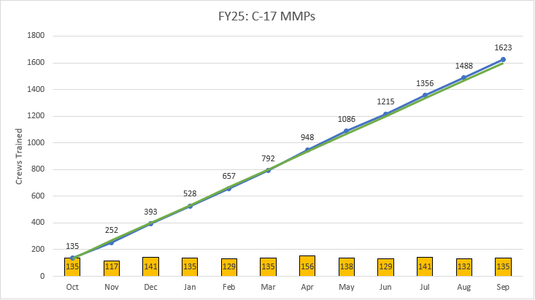
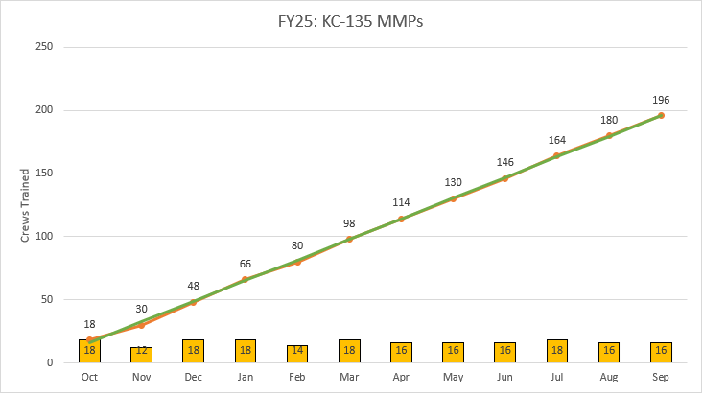
Event Management
MMP schedule on pace for CONOPS FY25 request
  C-130J reduced requirement Oct 2024 (2x MMP / month)
Always looking for ways to increase MMP utilization
  Analyzed Day of Week / Time of Day
  Moved some LX (afternoon events) to MX (mid morning)
TODAY
Notes:
KC-135 MMPs NOV 12*

Slide 17
MAF Mission Profile (MMP)
Three Main Desired Learning Objectives (DLOs):
        Blue Force Integration
        Use and understanding of Combat Communications and Brevity Terms
        Operate their aircraft in a robust, near-peer, evolving threat environment
          Adversary: Peer equipped, but not Night-1 of the war.
          Strike, Counter-Air, Escort & SEAD communications
          Tactical C2 procedures & communications
          Pre-briefed & pop-up threat reactions
          Mobile air defense, Air Defense Artillery, IR & RADAR guided threat engagements
          Rotary-wing & Fixed-wing threat engagements
          Communication jamming
          On-Call Airdrop
          Semi-prepared Runway & Tactical Landing Zone ops
What is AMC’s view on crew being prepared / acceptable to participate?
        Should Sim instructors let the crews log IMS-3 qualifications?
          Lack of Pre-mission Study (Academic viewing / Route Study / Mission Task Order understanding)
          Constant improvement & competency vs show and go exposure
          Commanders expect a level of proficiency from their crews when that bean is counted

Slide 18
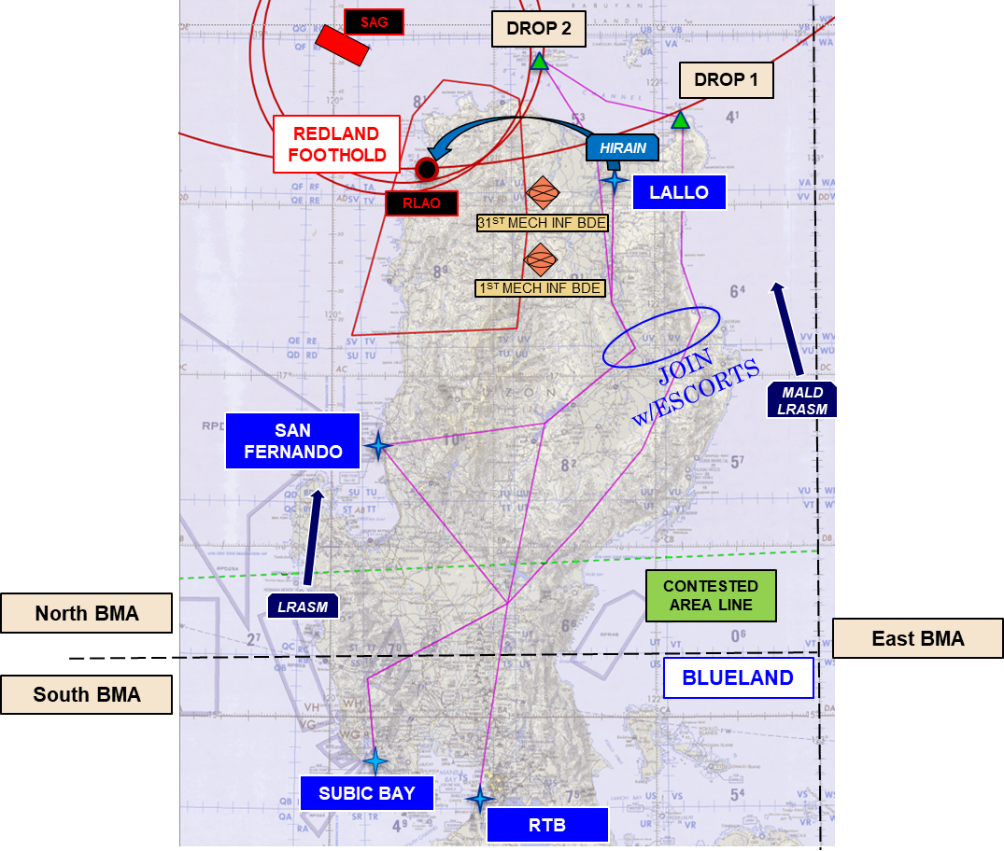
MAF Mission Profile (MMP)
Current Scenario (Korea AOR)
        No Changes
Next Scenario (Philippines AOR)
        Ready for deployment (C-17 Vis database delay)
        WEPTAC WG input
        All MDSs in the same AOR

Slide 19





FVEY Coalition Training Support
Provide Coalition Mobility Air Forces an opportunity to train together against a peer threat in a Contested or Denied Operating Environment.
Event Capstone Schedule
MMP 25-2 (19-20 Feb 25) On Track
CVG 25-2 (12-13 Mar 25) DMOC Conflict
MMP 25-3 (14-15 May 25)
CVG 25-3 (11-12 Jun 25)
MMP 25-4 (13-14 Aug 25)
CVG 25-4 (10-11 Sep 25)
“This is a great Coalition environment to practice like we would actually execute.”
Coalition training environment supporting multi-MDS (C-17/C-130/KC-135)
Execute TTP's in a contested environment
Academics and In-depth debrief w/ mission playback
Transition CVG to new scenario
Expectation of Coalition partners to take on lead planning roles

Slide 20
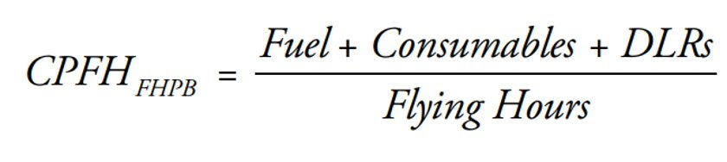
Training Cost Avoidance
Each analysis is divided into each MMP scenario offered (C-17, C-130, and KC-135)
Among these offers, each MMP is separated with and without surface ship operations
All playable entities are sorted from Red and Blue origins
Cost avoidance calculations are strictly from operating cost
Scenarios values are on the extreme conservative side
MMPs are an exposure event
Notes:
Note there was a schedule change
depot-level reparable

Slide 21
Scenario Allocation
Notes:
Note there was a schedule change

Slide 22
Scenario Allocation
Notes:
Note there was a schedule change

Slide 23
2024-2025 Monthly Count Running Total
2024 Monthly Running Total
Month | MMPs | Crews | Crews/MMP
Jan-24 | 46 | 59 | 1.283
Feb-24 | 42 | 67 | 1.595
Mar-24 | 42 | 74 | 1.762
Apr-24 | 45 | 74 | 1.644
May-24 | 48 | 75 | 1.563
Jun-24 | 32 | 56 | 1.750
Jul-24 | 35 | 64 | 1.829
Aug-24 | 44 | 84 | 1.909
Sep-24 | 37 | 77 | 2.081
Oct-24 | 44 | 91 | 2.068
Nov-24 | 30 | 58 | 1.933
Dec-24 | 36 | 68 | 1.889
Total | 481 | 847 | 21.31
Average | 40.0 | 70.6 | 1.78
2025 Monthly Running Total
Jan-25 | 33 | 74 | 2.24
Total | 33 | 74 | 2.24
Average | 33.0 | 74.0 | 2.24
Total | 514 | 921 | 24
Average | 39.5 | 70.8 | 1.81
2.54
2.61
Notes:
Note there was a schedule change, add percent btw PMRs, and distance btw R&B
FY24 Oct
About a 9% increase in Crew/MMP after the schedule optimization

Slide 24
Cost Matrix Example Jan-24
 | Cost Analysis
 | MMP Environment Cost | Separated Monthly Cost | Without Crew Flt hrs | MMP Monthly Cost
C17 | $2,210,193.44 | $92,828,124.63 | $92,828,124.63 | $95,972,034.63
Crew | $57,162.00 | $3,143,910.00
C130 | $2,210,193.44 | $2,210,193.44 | $2,210,193.44 | $2,245,773.44
Crew | $35,580.00 | $35,580.00
KC135 | $2,581,657.71 | $7,744,973.12 | $7,744,973.12 | $7,971,353.12
Crew | $75,460.00 | $226,380.00
 |  |  | TOTAL
 |  |  | $102,783,291.19 | $106,189,161.19
Notes:
Note there was a schedule change

Slide 25
2024-2025 Monthly Cost Running Total
2024 Monthly Running Total
Month | No Ship Ops | Ship Ops
Jan-24 | $106,189,161.19 | $374,958,339.21
Feb-24 | $98,538,759.95 | $348,246,294.13
Mar-24 | $99,426,714.21 | $351,040,412.78
Apr-24 | $107,226,581.34 | $381,714,252.50
May-24 | $112,297,096.61 | $396,315,589.69
Jun-24 | $75,887,803.51 | $268,410,406.21
Jul-24 | $83,693,742.37 | $297,184,153.28
Aug-24 | $104,728,723.36 | $369,685,572.62
Sep-24 | $88,145,740.73 | $309,260,809.17
Oct-24 | $104,399,064.84 | $365,543,585.32
Nov-24 | $70,747,322.10 | $248,020,609.73
Dec-24 | $76,116,451.51 | $268,639,054.21
Total | $1,127,397,161.73 | $3,979,019,078.85
Average | $93,949,763.48 | $331,584,923.24
2025 Monthly Running Total
Jan-25 | $78,270,912.43 | $272,699,679.350
Total | $78,270,912.43 | $272,699,679.350
Average | $78,270,912.43 | $272,699,679.350
Total | $1,214,966,143.94 | $4,283,890,800.73
Average | $93,458,934.15 | $329,530,061.59
Notes:
Note there was a schedule change

Slide 26
Supporting Documents for Creditability
Weapon System Sustainment Navy Ship GAO-23-106440 January 2023 Report to Congressional Committees
  Over 100 pages of related data to all used naval entities.
Congressional Budget Office: Operating Costs and Aging of Air Force Aircraft
  The National Academies of Sciences, Engineering, and Medicine Air Force Studies Board Washington, D.C. January 23, 2019
Fiscal Year (FY) 2021 Department of Defense (DoD) Fixed Wing and Helicopter Reimbursement Rates
  Office Of The Under Secretary Of Defense
AIR FORCE INSTRUCTION 11-102 8 DECEMBER 2020
  Flying Operations: Flying Hour Program Management
Notes:
Note there was a schedule change

Slide 27


Standards Change Candidate
Event Management Standard Needs a Scrub
  Confusing Terminology
  Table Headers
  Definitions
Can be Dual Purpose
  Update the Standard
  Educate CLS on Roles/Responsibilities
Notes:
Note there was a schedule change

Slide 28
Metrics and Reporting Issues
Issue: Metrics are Not Accurate for Non-MMP Daily Persistent Training … using Scheduled, not Actual. Request HII Report Back on Plan to Fix.
Issue: CLS do Not Comply with Event Management Standard Reporting Requirement. Per the Standard, ATS Contractors are to “Complete and submit a MAF DMO Event Completion Report to the DTC”, “Within 24 hrs of event completion”.
  Solution: Address at RTRB, Government-Only Integration Meetings, & at PMR
  Request HII Brief the Requirement on Day 2 of the PMR with the ATSs and at the MSWG
  Request HII Establish a Standard Report Template for CLS to Use
Notes:
Note there was a schedule change

Slide 29
Details
Network monitoring is provided during DTC operational hours (0700-1700 Central)
Unit(s) may conduct non-MMP training events 24/7 without DTC network monitoring
Non-MMP training event objectives and activities are unit planned, and unit led; MAF DTC whiteforce is not provided
MAF DTC cannot determine the type non-MMP training accomplished without input from the participating site(s)
MAF DMO standards require units to submit a summary of training accomplishment to the DTC help desk for all non-MMP training events
HII has not been receiving the summary of training for non-MMP training events. Will ask CLSs on Day 2 to resume this process
Notes:
Mention DPT?
Example of what we see?:
DMO Event Category Trg Activity Activity ID Event Code Date Time Base MDS DMO Msns Sims Hours Pers Trained
Training DPT KC-135 Form Event/DPT 01-02-24 12:00 Scott AFB KC-135 1 1 5 3

Slide 30
Requested Data (Requires AMC Validation)
Type of training
  Formation
  V-VAR
  TTP Development
  Real World Mission Rehearsal
  COCOM exercises
  Other
  Combo

Slide 31
COA 1: MAF DMO Standards Compliance
CDRL A013 Event Management Standard (EMS), 14 Feb 2024
“MAF DMO standards apply to all Aircrew Training Systems (ATSs) participating in the Distributed Training Center Network (DTCN).”
3.3.2.5 EC (Completion of a formation event)
  Once the event is completed, each ATS CLS contractor will complete and submit a summary of training accomplishment to the DTC help desk, which includes date/time of activity, participating bases, Mission Design Series (MDS), number of participating simulators, training time log, number of personnel trained and remarks to include any technical issues. The MAF DMO O&I contractor will manage the information collected and provide it to AMC upon request.
3.4.1.5 EC (Completion of LFE, TTP Development, Msn Rehearsal, Testing)
  Once the event is completed, the respective ATS contractors will complete and submit a MAF DMO Event Completion Report to the DTC. This report will allow the collection of information and metrics as determined by AMC.
Benefits
Most accurate source of data
No change to existing contracts or standards is required to achieve AMC’s desired result
Risks
CLS neglects to send a training summary

Slide 32
Example Completion Report
Emailed to A3.DTC@us.af.mil
Subject: MAF DMO Training on the DTCN
Date & Time training began
Type of training (Formation, VVAR, TTP Dev, Msn Rehearsal, Other)
Duration of training
Participating Unit(s) and MDS
# of personnel trained
Any remarks

Slide 33
COA 2: Additional Hire
Hire personnel to watch all connections to the network, parse raw data pulls, and contact units for training details.
Benefits
Data is gathered from the source (ATS instructor)
Risks
Must be able to contact the specific CLS instructor who conducted the training
  MAF DTC cannot determine real-time what training is being conducted
  Might be days before instructor contact, leading to some loss of details (accuracy)
Additional cost
Not supported outside of DTC operational hours (unless paying for 24H support)

Slide 34
COA 3: Network Reservations
Sites schedule time in advance to use the DTCN for non-MMP training
MAF DTC creates the event in DMOSS after ATS provides training details for the data collection
MAF DTC will ‘unlock’ access to the DTCN for the participating units during the date/time/exercise ID# requested
Benefits
MAF DTC will have visibility on all activities on the DTCN (Gatekeeping)
Risks
Customer frustration
Unable to conduct short-notice training if trying to schedule outside DTC Operational hours
Data will be planned training type/duration, not necessarily what occurred
DTCN would no longer fit the definition of a Persistent, 24/7 Network

Slide 35
COA 4: Specific Exercise ID
Use specific exercise IDs to differentiate the type of training conducted on the DTCN
Create a DTCN database to capture Exercise ID, site and duration of DMO connection
Benefits
Automated process to pull information based on ATS input
Risks
Limit of Exercise IDs from 1-255 (currently using 1-155)
  Unique IDs required for user deconfliction
Moderate chance for bad data
  Unit used the wrong code = wrong training information
  Unit remains logged into DMO while conducting local training
  Data must be manually input to unclassified database

Slide 36
Undeveloped COAs
ATS Activity Reports
  Do the ATSs submit reports (CMAR) to the Program Office / AMC?
  Reports may contain proprietary information not meant for HII
TMS Access
  Would need to know the specific students that trained
  Would need access to TMS data
  May not have the level of detail desired

Slide 37
COA Summary
COA 1: MAF DMO Standards Compliance Recommended
No changes required, only compliance to existing documentation
Highest level of data accuracy
COA 2: Additional Hire
Challenge to identify and contact the correct people
  Time delays in reaching sim instructor
  Degrade accuracy of data
No monitoring outside business hours (unless 24hr contracted support)
Additional cost
COA 3: Network Reservations
All planned activity on the network is known and reported
Planned training scheduled vs actual training
Potential for customer frustration
COA 4: Exercise ID
Limitations on number of Exercise IDs
Moderate risk for incorrect data and manual data transfer to unclassified database

Slide 38
Questions to Government
What level of detail is required for each type of training?
  What reports will this data influence?
  Do you need an accurate count for personnel trained?
  Do you need the crew’s base if different from the site location?
Do we need to report training conducted between C-17 Cockpit sim and Loadmaster sim?
  DTCN use required for the connection
  Does not fit any of the current MAF DMO training activities

Slide 39
Systems Engineering

Slide 40
Configuration & Data Management
Year in Review
  Added 14 CDRL deliverables since the last PMR
  Delivered 156 CDRL/CRM documents on time (93% on time rate)
  28 CDRL deliveries with first-time quality (no CRM’s) since the last PMR (72%)
  OY02 Success Rate (does not include A001 or A002): 86%
  A022 Product Drawings Models and Associated Lists:
  HII turned in Wright Patterson and Dyess drawing sets on 8 November 2024
  BOM design / configuration alignment between HII and government achieved
  Since the last PMR, an offset was implemented on all CDRL deliverables, improving the review cycle and on-time delivery.
  Team Manning:
  The Data Governance team has been fully stood-up, lead by the Configuration Manager. Team includes two technical writers, a data manager, QA, and configuration analyst.
  With the additional manning, Data Governance has provided the team support on document development and on-time delivery of CDRLs/CRMs, decreasing the number of CRMs.

Slide 41
Configuration & Data Management
On the Horizon
  Sidebar to discuss Form 1423 Block 8 Approval Status
  Between now and the end of the option year, 11 additional CDRL deliverables are due.
  Team is working with all the leads to improve internal documentation.
  Process Improvement steps include:
        Standard review process for all documents
        Incorporation of QA into review cycle
        Improved access to document templates, increasing standardization across documentation
        CM control on document control and drawing numbers
  Future Steps to Improve Data Management:
        Updated MAF DMO website with stricter configuration controls
        New SharePoint site on the UCN network, increasing MAF DMO ownership and control of access / configuration control
        CRM process standardization (receipt to delivery, streamlining the process for CRM)

Slide 42
Engineering/Contract Change Proposals
PCOL | Description | Status | Notes
MAF-DMO-2022-010 | Software Support Request for Proposal (RFP) | Awarded
MAF DMO 2023-0012 | Software License & Warranty RFP | Awarded
MAF DMO 2023-0014 | TACLANE RFP | Awarded
AFLCMC/WNS-RFP-23-167 | Windows 11 Migration RFP | Awarded
MAF DMO 2024-0004 | FVEYS Coalition Training Support RFP | Awarded
MAF DMO 2024-0127 | Product Support RFP | Awarded
MAF DMO 2024-0169 | Product Support RFP Amendment | Awarded
MAF DMO 2024-0215 | FVEY Connection ROM | Closed
MAF DMO 2024-0254 | FVEYS Partner Connection and V-VAR RFP | Offer Accepted
MAF DMO 2025-0006 | TACLANE & Trellix RFP | In Work | Proposal due 14 Feb 2025

Slide 43
GFE Accountability & PCAs
All MAF DMO inventories complete with the exception of Charleston AFB
  Charleston AFB scheduled for 10 – 13 Feb
PCAs on hold pending drawings acceptance
DD 250 discussion sidebar with Mr. Blevins
Possible Drawings Sidebar

Slide 44
Let’s Take a Break!
10:05 – 10:15

Slide 45
Cybersecurity

Slide 46
Cybersecurity Status
MAF DMO Cyber Team increased to total of 5
  4 located at Orlando
  1 located at Scott AFB
  3 have SIPR tokens, remaining 2 awaiting approval
Cyber Documentation Overhaul (Project PaperCut)
  Revision/renewal of all MAF DMO MOA/ISAs
  Rewrite of SSPs to address all Security Controls to the CCI level
  Closely working with CM to identify all MAF DMO documentation and develop version control processes and procedures
Preparation for DTCN ATO renewal
        Identifying high priority vulnerabilities for mitigation
        Initiated STIG evaluations
Planning for IAN FISMA Review
        Identify Security Controls to review
        STIG evaluations

Slide 47
MAF DMO ATOs
Platform | Auth Type | Expiration | GPO ISSM email | O&I ISSM email | Notes
C-130J MATS | ATO | 21NOV2026 | brad.sayles.ctr@us.af.mil |  | 2 year
KC-135 TS | ATOw/C | 03JUNE2025 | ronald.burns.17.ctr@us.af.mil |  | 6 month
C-17 Corona | ATO | 31DEC2026 | raymond.dom.1.ctr@us.af.mil walter.van_daele.2.ctr@us.af.mil |  | 2 year
SCARS OPE | ATO | 20JUN2025 | jeremy.holmes.9@us.af.mil | david.cooper@saic.com | 1 year
SCARS iSOC | ATO | 20JUN2025 | jeremy.holmes.9@us.af.mil | david.cooper@saic.com | 1 year
HTEN | ATO | 01FEB2026 |  |  | 2 year
JTEN | ATO | 31AUG2025 |  |  | Maintained on SIPR
C-5 | ATO | 18NOV2025 | james.yannekis.ctr@us.af.mil |  | 1 year
C-17 ATS | ATO | 29MAR2025 | raymond.dom.1.ctr@us.af.mil walter.van_daele.2.ctr@us.af.mil |  | 1 year
KC-46 | ATO | 28FEB2028 | brian.hale.4.ctr@us.af.mil |  | 3 year
KC-135 BOSS | ATO | 22JUN2025 | Justin.rominski.ctr@us.af.mil |  | 2 year
DTOC, ARCNet | ATO | 12JAN2026 |  |  | 2 year
MAF DMO DTCN | ATO | 25JUL2025 | timothy.lewis.42.ctr@us.af.mil | christine.taylor.12.ctr@us.af.mil | 1 year
MAF DMO IAN | ATO | 25JUL2026 | timothy.lewis.42.ctr@us.af.mil | christine.taylor.12.ctr@us.af.mil | 2 year

Slide 48
IT Services and Integrated Systems

Slide 49
Upgrade and Modification
Review: OY1-2 Upgrade/Mod Initiatives
Deploy virtualization across the enterprise: Complete
Transition system configuration management, deployment and patching from KACE to Satellite & SCCM: Complete
Windows 11 and Server 2019 Upgrades: ~98% Complete
  Last 5 Lab systems scheduled for upgrade in mid-February due to testing schedule.
CM and automation improvements: ~50% Complete
  Management systems are stood up. Will continue to configure additional CM and automation capabilities in OY3.
Deploy Virtual Desktop Infrastructure on UCN: ~50% Complete
  A working solution for standard workstations is implemented on the UCN.
  Need to implement and evaluate solution to replace Ops and Lab workstations.
DTCNB Elimination - Proof of concept: Complete
  Details of findings on later slide.

Slide 50
Upgrade and Modification
Upgrade Initiatives for OY3
CM and automation improvements:
Establish configuration compliance monitoring and enforcement
Deploy Ansible and increase the use of automation/scripting
HW Refresh:
GW/TestPC
  Dell R360 servers will refresh all GWs and TestPCs
BDB
  BDB systems will be refreshed with Optiplex 7010/7020 Micros
  7020 - Pending submission and approval of MERB/MCCB
UPS
  Site UPS will be replaced with Vertiv UPS and External Battery pack
Router
  Site routers will be refreshed with Cisco 8200 devices
  Pending submission and approval of MERB/MCCB

Slide 51
Upgrade and Modification
Modification Initiatives for OY3
Virtual Desktop Infrastructure Evaluation and Deployment:
Complete evaluation on UCN: ~July 2025
Complete deployment on DTCN: ~Feb 2026
DTCNB Elimination Implementation:
Pending discussion of proof-of-concept findings
Ready to immediately submit circuit requests
Targeting completion by the end of OY3

Slide 52
Upgrade and Modification
DTCNB Elimination
Proof-of-concept findings:
Change deployed to Scott KC-135
Event on Jan 16th was cancelled, so a test of comms and non-comms was conducted with the DTC. No issues were identified.
Due to the low-risk nature of this change, recommend moving forward with the phased implementation as detailed below
Order/phases of implementation:
Phase 1 – Deploy change to one site for each platform
  Monitor selected sites for issues for at least one event each
  Continue to Phase 2 if no issues are identified
Phase 2 – Deploy change to all single-SIM sites
  Continue to monitor all sites
  Continue to Phase 3 if no issues are identified
Phase 3 – Deploy change to all multi-SIM sites

Slide 53
Qualification and Test C-17
CTP dry run – WST 19 St Louis 14-16 Jan ’25 (complete)
    CTR & TCA
Certification & Acceptance testing
  WST 28 Charlotte
    Certification 29-30 Jan ’25 (complete)
    Acceptance 31 Jan ’25 (complete)
      MATR Package in progress
  WST 27 Pittsburgh
    Certification 12-13 Feb ‘25
    Acceptance 14 Feb ‘25

Slide 54
Qualification and Test KC-135
Certification and Acceptance schedule TBD
  Pending site install schedule
  Review/Update CTP required

Slide 55
Qualification and Test KC-46
Spiral development & testing to v5.1 standard (complete)
Dry run of v5.1 CTP (complete)
  CTR (complete)
  CTP updated with lessons learned
  TCA updated
Certification & Acceptance
  Recent decision to certify sites to v5.1
Transition to v13 Standards anticipated Mar-Apr ‘25

Slide 56
Qualification and Test C-5
Spiral testing and CTP standards v9.1 update (complete)
Update CTP with MAF tools updates needed
Certification & Acceptance testing
  Dates TBD after scheduled site installations
        Westover site install April ’25
        Lackland site install May ‘25
        Dover site install June ‘25
Standards v13 upgrade
Schedule TBD

Slide 57
Qualification and Test C-130J
TAC-F release for Yokota
C-130J limited release to CAE/LMCO – 23 Jan ’25
SIMCERT 4-5 Feb ‘25 – SPR/DC verification

Slide 58
Qualification and Test (Tools)
Tools Review and progress
TAC-F next steps
  Core software complete in March 2025
  C-130J scripts almost complete for v7 standards
  C-5 (v9.1, v13) and KC-46 (v13) custom scripts are next

Slide 59
Software Tools Development
TAC-F
  Development complete early March
  Cyber acceptance and CDRLs still needed
  Expect updates after introduction to platforms
DISPlayTool (DPT)
  In maintenance phase
  8 Weeks
HIIFly
  Phases in Weeks
    1st - 14
    2nd - 20
    3rd(Final) - 16
PHANTOM
  4 Weeks
SERPENT
  3 Weeks
JETSTREAM
  2 Weeks
DATACOMET
  7 Weeks

Slide 60
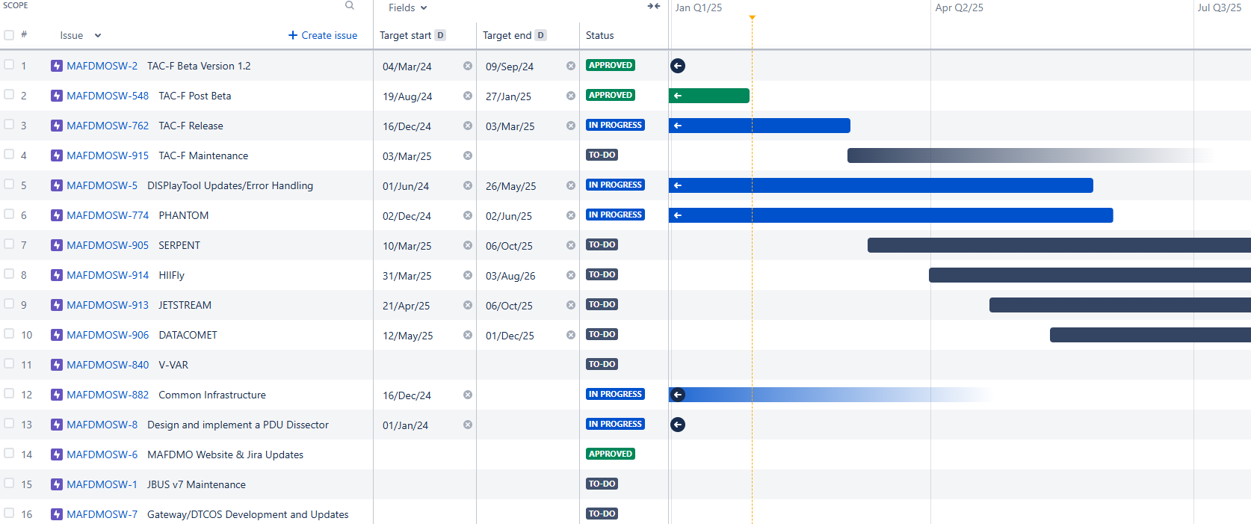
Software Tools Development

Slide 61
Interoperability
Standards & Integration Plans (Draft) version 14.0
  Delivered 31 December 2024; awaiting CRM.
Standards & Integration Plans (Draft) version 15.0
  Versioning discussion; align with CAF? V26 vice V15.
  New Topics
    Shared Weather Baseline in DMO
    C-17 Topics
      MAF DMO Interface Standard Section 7.1.3
    KC-46 Topic
      Boom Interphone
      Anti-Collision Flash Codes
    C-5 WST SATCOM Requirement
    Shared Weather Baseline in DMO
    Event Management Standard Table 3-2
  On Hold Topic – Training Assessment
    Weather in MAF DMO

Slide 62
Interoperability
V12.1 Connectivity Process Map
  Final delivered on 9 Oct.
Upcoming Meetings
  6 Feb – MSWG (2pm – 4pm, Day 2 of PMR/via MS Teams)
  10 – 13 Feb – SISO Simulation Innovation Workshop (F2F in Orlando, FL)
  19 Feb – CAF Standards Development Working Group (F2F in Orlando, FL)
  8 Apr – MSWG (2pm – 4pm via MS Teams)
  10 Jun – MSWG (2pm – 4pm via MS Teams)
  7 Aug – MSWG (2pm – 4pm, Day 2 of PMR/via MS Teams)

Slide 63
SCARS SMP
Increment 4 Standards posted to collaboration site.
Increment 5 Standards Topics of Importance
  Virtual Machines
    Addressing impacts to affiliate software hosted on VMs
  Extended Reality Interfaces
  IOS (remote or otherwise) Framework
    Aptima to present topic with derived requirements
  Brief/Debrief Systems
    Aptima to present topic with derived requirements
  JSE/Grid
    Using Gov Sim Interface (GSI) ICD as a standard interface
    Monitor progress of integration with JSE Platforms In a Box (PIABs)
Pathfinders – currently on hold until further notice.
SCARS SECB
  25/26 Feb (F2F in Orlando, FL)

Slide 64
V-VAR

Slide 65
V-VAR
C-17 and KC-135 V-VAR capability delayed (2026)
Way Forward in 2025?
Improve V-VAR capability in test tools
Potential Opportunity for Other Platforms
C-5 with some assist from KC-135
KC-46 Spiral development to v13 standard

Slide 66
Controlled Interface
-FYEYS Partner Connection

Slide 67
CI Affected Items
Program CDRLs
        No new CDRLs
        Adds info CDRLs A005, A006, A008, A022, A023, A032, A035, A043, A047, B001, B002, B003 and C003.
Program CLINs
        No new CLINs
        Additional effort required for CLINs 3014, 4014, and 5014.

Slide 68
CI Justification
Preliminary Analysis:
        Initial engagement with NCDSMO of the NSA
  Networks are not hierarchically different (both SECRET)
  Info exchange is w/FVEYS partner networks (REL to USA/FVEY)
Assumptions:
CDS not required, only Controlled Interface
CI is not required to meet NCDSMO RTB Requirements
FVEYS Partner Connection does not require a full assessment as described in NCDSMO-R-00003-004_00

Slide 69
CI Alternatives
Firewall with Full CDS:
        DTCN ←→ CDS ←→ FVEYS
  SimShield
  Enterprise Network Guard (ENG)
Firewall Only as a CI:
        DTCN ←→ Firewall ←→ FVEYS
  Meets NCDSMO req., but not req. of PWS for English language rules, ruleset locking, logging.
Firewall with Application Gateway
        DTCN ←→ MAF DMO Gateway ←→ FVEYS
  MAF DMO gateway has not been applied to use case.
  Mods required to python-based filter subsystem
  Existing performance limits
  Dev Team limited experience
        DTCN ←→ JBUS ←→ FVEYS
  Similar use case between NETTN and FVEYS
  Requires enhancement of existing plugins to meet locking, verification, field-level rules for MAF DMO.

Slide 70
CI Considerations
Firewall with Application Gateway (JBUS)
        Risk Reduction
  Firewall and Server HW are the same models currently approved for us on the DTCN
          Lower Risk for RMF and AO approval
  Approved for similar use case, provides less risk for NCDSMO and WNR AO
  HII has extensive JBUS and JBUS Plugin development experience
Firewall Only as a CI:
        DTCN ←→ Firewall ←→ FVEYS
  Meets NCDSMO req., but not req. of PWS for English language rules, ruleset locking, logging.
Firewall with Gateway Application Gateway
        DTCN ←→ MAF DMO Gateway ←→ FVEYS
  MAF DMO gateway has not been applied to use case.
  Mods required to python-based filter subsystem
  Existing performance limits
  Dev Team limited experience
        DTCN ←→ JBUS ←→ FVEYS
  Similar use case between NETTN and FVEYS
  Requires enhancement of existing plugins to meet locking, verification, field-level rules for MAF DMO.

Slide 71
Current DTCN Interface to FVEYS

Slide 72
Proposed FVEYS CI Relative to DTCN Boundary

Slide 73
CI DTCN Network Updates
FVEYS Interface Firewall
        Install firewall between MAF DMO boundary DTCN router and JTEN
          Cisco Firepower 1120 configured same as MAF DMO site kit baseline
          Intrusion prevention from JTEN
          Enforces allow/block rules to limit traffic across DTCN
          Filtering at network layer (port, protocols, and source and destination network addresses
          DIS and VoIP transit firewall bi-directional
FVEYS Gateway Application Gateway Server
Install server HW between DTCN and FVEYS interface firewall
  Dell R360 configured same as MAF DMO site kit baseline
          Hosts FVEYS Gateway Application Gateway SW
          Includes OS, implementation of, and integration with MAF DMO SSP
FVEYS Gateway Application Gateway Software
Update GOTS JBUS SW on FVEYS Gateway Server
  Provides application layer filtering and guising of simulation data over DIS protocol
          Enhance existing JBUS SW to implement cryptographic ruleset signatures, config data and SW baseline ensuring only AO approved versions used
          Logging data traversing gateway

Slide 74
CI Approval of FYEYS Interface on DTCN
Require AO approval for operation of FVEYS interface for DCTN and NCDSMO
        Work with cognizant USAF CDSE to initiate creatin of tracing ticket with NCDSMO
        Prepare and present briefing of proposed architecture to NCDSMO for approval
        Draft modifications of DTCN cybersecurity CDRLs and CIEs for review by WNR
        MAF DMO AO authorization of FVEYS interface to DTCN

Slide 75
CI Rulesets
Ruleset WG
        Personnel experienced with DIS protocols, DTC operations, MAF platform characteristics/missions, Tactics, Techniques and Procedures
        Rules for data filtering data
          SECRET to SECRET//REL TO USA, FVEY
        English Language Rule Plan
        Event test verification
          Configuration
          Technical
          Operational

Slide 76
CI Test Plan
Conformance to ELRP and TRs
        Use of GOTS I&T tools verify restricted data does not transit interface
          DISPlay
          TAC-F
          WireShark dissectors

Slide 77
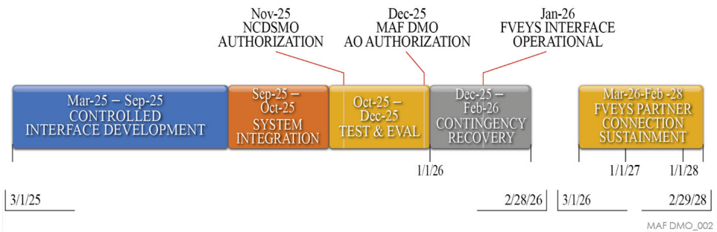
CI Timeline

Slide 78
Action Item Review

Slide 79
Thursday, 6 February 2025 (Day 2)
The Celeste Hotel, Orlando, a Tribute Portfolio Hotel (4105 N Alafaya Trl, Orlando, FL 32826)
Teams Meeting: Click here to join the meeting; or call-in +1-757-716-0190, Phone Conference ID: 502 594 648#

Slide 80
AUGUST 2025 PMR
The next PMR is tentatively scheduled for 6-7 August 2025 at O’Fallon, IL

Slide 81
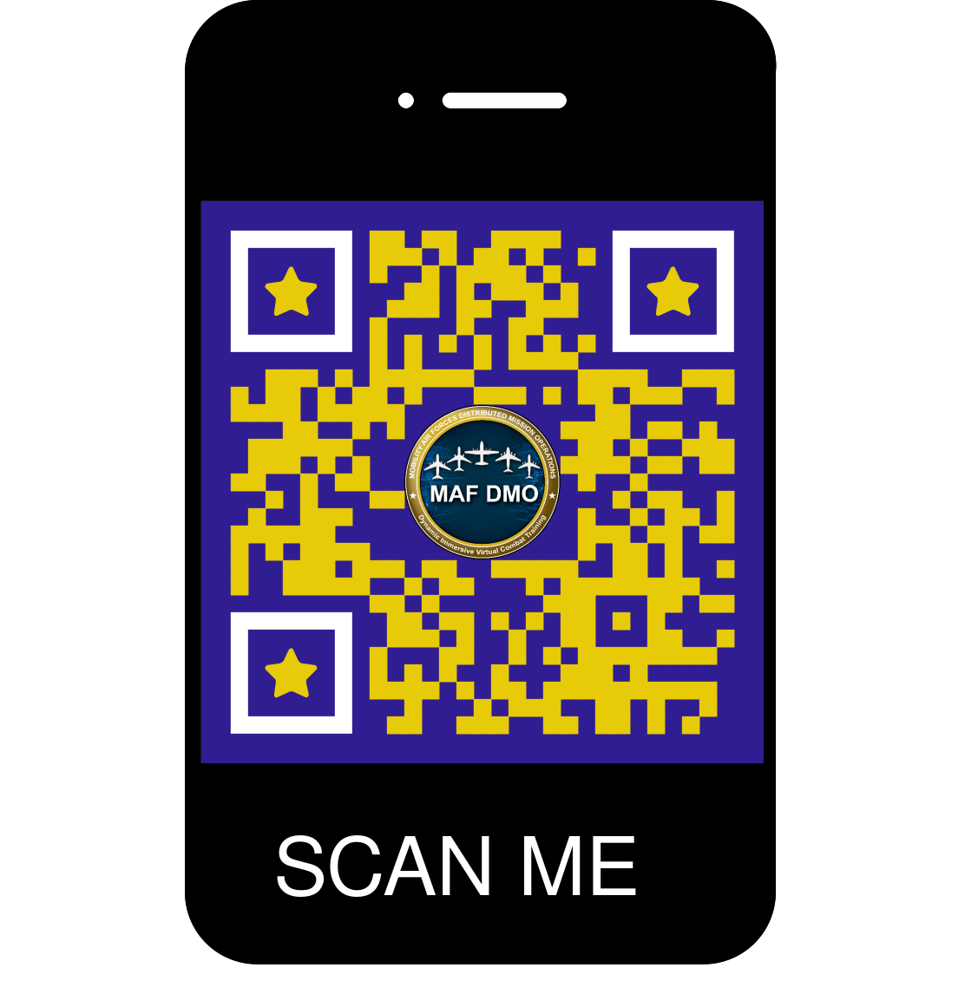
PMR Survey
For those planning to participate in both days, DO NOT complete this survey until the end of Day 2.
The survey has the option to be anonymous.

Slide 82
Break For Lunch!
12:00 – 13:30

Slide 83
Side Bars
13:30 – 15:00

Slide 84
Side Bars
DD250 Discussion
TS/SCI Discussion
1423 Discussion

Slide 85
MAF DMO C-17 MMP Viewing
16:00
2603 Challenger Tech Ct 140, Orlando, FL 32826
Visit request required – Theresa Starr (407) 569-7772, SMO Code 7BPG9, Theresa.L.Starr@hii.com

