Slide 1
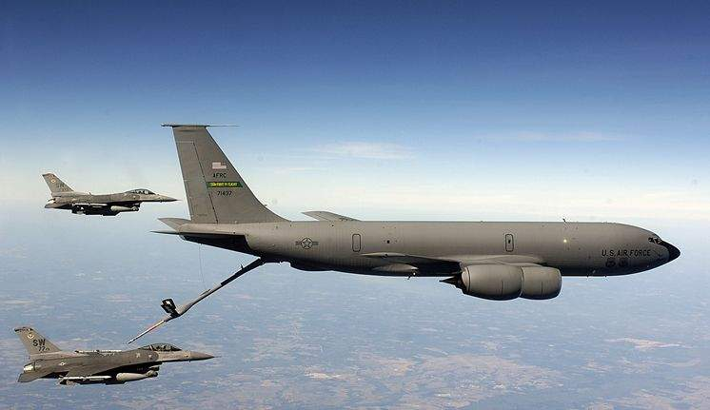
CUI// SP-CTI / SP-EXPT
Mobility Air Forces (MAF)
Distributed Mission Operations (DMO)
Program Management Review
Mission Technologies
A division of HII
FA8621-15-D-6268/FA8621-22-F-6268
Date: 6 February 2025 (Day 2)
John “Shack” Shackelford
MAF DMO PM
Controlled by: MAF DMO
Controlled by: AFLCMC/WNS
CUI Category(ies): CTI, EXPT
Distribution Statement: D
POC: John Shackelford
407-737-3599 Ext. 527
CUI// SP-CTI / SP-EXPT
Notes:
POC: Shack
Briefer: Shack

Slide 2

Mobility Air Forces (MAF)
Distributed Mission Operations (DMO)
DISTRIBUTION STATEMENT D:
Distribution authorized to the Department of Defense (DoD) and U.S. DoD Contractors only: in accordance with Contract FA8621-15-D-6268/Delivery Order FA8621-22-F-6268, 1 July 2022. Other requests must be referred to the USAF Simulators Division, AFLCMC/WNS MAF DMO Program, 2300 D Street, Bldg. 32, Wright Patterson AFB, OH 45433-7249
EXPORT CONTROL WARNING:
Warning: This document contains technical data whose export is restricted by the Arms Export Control Act (Title 22, U.S.C., Sec 2751, et seq.) or the Export Control Reform Act of 2018 (Title 50, U.S.C., Chapter 58, Sec. 4801-4852). Violations of these export laws are subject to severe criminal penalties. Disseminate in accordance with provisions of DoD Directive 5230.25 and DoD Instruction 2040.02.
DESTRUCTION NOTICE:
Destroy by any method that will prevent disclosure of contents or reconstruction of the document.
DISCLAMER STATEMENT:
Per AFLCMC/WNS & AFLCMC/WN direction, Rules of Engagement for MAF DMO meetings & telecons:
This is a reminder that no one in these discussions has the authority to direct the contractor to alter contract requirements or to modify in any way the legal responsibilities under the contract. Only the Contracting Officer has that authority.
If the US Air Force, as a result of these discussions, does desire to change any requirements under the contract, direction will be provided in writing, signed by the Contracting Officer.
No action should be taken on any perceived changes to current contractual requirements until written CO direction is provided.

Slide 3
Agenda Thursday,
6 February 2025
(Day 2)
The Celeste Hotel, Orlando, a Tribute Portfolio Hotel (4105 N Alafaya Trl, Orlando, FL 32826)
Teams Meeting: Click here to join the meeting; or call-in +1-757-716-0190, Phone Conference ID: 502 594 648#
0830 – 0845 EST: Introductions and Opening Remarks
0845 – 0945 EST: ATS/CLS Operations & Integration Discussions
  Program Timeline
  Distributed Training Center (DTC)
  ATS/MDS Connectivity Status Updates
0945 – 1000 EST: Break
1000 – 1100 EST: ATS/CLS (Quad Chart) Briefings
  C-130J MATS
  C-17 ATS
  KC-135 ATS
  KC-135 BOSS
  KC-46 ATS
  C-5 ATS
1100 – 1105 EST: Action Item Review
1110 – 1200 EST: NGTS
1200 – 1300 EST: Lunch
1300 – 1400 EST: Side Bars
1400 – 1600 EST: MAF DMO Standards Working Group: Teams Meeting
1600 – 1700 EST: MAF DMO KC-135 MMP Viewing
1615 – 1700 EST: MAF DMO Tools Demo / Facility Tour

Slide 4
Introductions and Opening Remarks

Slide 5
MAF DMO Org Chart
John Scorsone
Director, MTS
Tampa, FL
Chris Schwindt
Solutions Architect
Orlando, FL
John Carswell
Solutions Architect
Daytona Beach, FL
MAF DMO Consultants / Special Projects
Christopher Nolan
FSO
Scott AFB, IL
Johnathon Shackelford
Program Manager
Orlando, FL
“Terri” Hutasewee
Program Control Analyst
Norfolk, VA
Theresa Starr
FSO
Orlando, IL
Shawn Hammack
Chief Engineer
Orlando, FL
Kaitlin Phan
Business Ops PM
Orlando, FL
Christi Taylor
Cybersecurity Engineer
Lead
Orlando, FL
Wayne Stilwell
Mission Engineering Lead
Orlando, FL
Richard Fraley
Software Engineering Lead
Orlando, FL
Anya Gustafson
Data Governance Lead
Orlando, FL
Arvo “Pyro” Sepp
DTC Site Manager
Scott AFB, IL
Chris Schejbal
IT Services Lead
Scott AFB, IL
Robert Russ
Integrated Systems Lead
Orlando, FL
Peggy Maddock
System Engineering Lead
Orlando, FL

Slide 6
ATS/CLS Operations & Integration Discussions

Slide 7
Program Timeline
Start of OY3
1 Mar
Firewall Refresh
Grissom KC-135
23-25 Jul
Firewall Refresh
132d CTS/DTOC
3-5 Dec
AMC/CC DTC Visit
18 Feb
MAF DMO PMR
24-25 Jul
TAC-F Testing
Tampa SIL
18-20 Sep
Firewall Refresh
Charlotte C-17
16-18 Oct
C-17 USAFWS Conference
24-26 Nov
TAC-F Testing
Tampa SIL
6-10 Jan
Bi-Lateral MMP 25-2
19-20 Feb
DTCN 1Yr ATO Renewal
12 Jul
Coalition Virtual Guardian 24-4
4-5 Sep
Tanker USAFWS Symposium
2-5 Oct
Site Survey
McConnel KC-46
12-14 Nov
Firewall Refresh
AFSOC
10-12 Dec
MAF DMO PMR
5-6 Feb
July 2024
August 2024
October 2024
November 2024
January 2025
February 2025
September 2024
December 2024
March 2025
Cert & Acceptance
Pittsburgh C-17
12-14 Feb
IAN 2Yr ATO Renewal
12 Jul
Firewall Refresh
Ramstein C-130
20-22 Aug
Firewall Refresh
Travis & March
29 Sep – 4 Oct
Airlift Tanker Association Conference
1-3 Nov
I/ITSEC 2024
2-6 Dec
Cert & Acceptance
Charlotte C-17
28–31 Jan
TAC-F Release
Early March
Firewall Refresh
Memphis & Jackson
6-8 Aug
Firewall Refresh
Fairchild KC-135
8-10 Oct
Firewall Refresh
Dyess C-130
19-21 Nov
Firewall Refresh
DMOC
17-19 Dec
Firewall Refresh
Charleston C-17
10-13 Feb
Start of OY3
1 Mar

Slide 8
Distributed Training Center (DTC)

Slide 9
Event Management
WEPTAC working group inputs to 2025 scenario
        Good collaboration from warfighter to MAF DTC planners
2025 Scenario implementation delayed due to C-17 Visual Database update
        Affects FY26 scenario
        Alternate projects to FY26 include roadshows, additional academics, audit Weapons School lectures, etc.
Updated Flight Plans required for KC-135 and C-5
        When to start new DMO sim MMP scheduling?
        3Q FY25 schedule is posted Mid-February in DMOSS for site planning

Slide 10
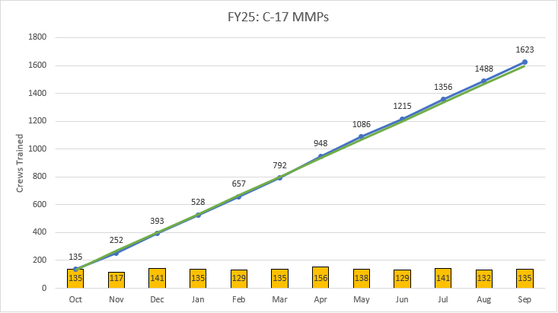
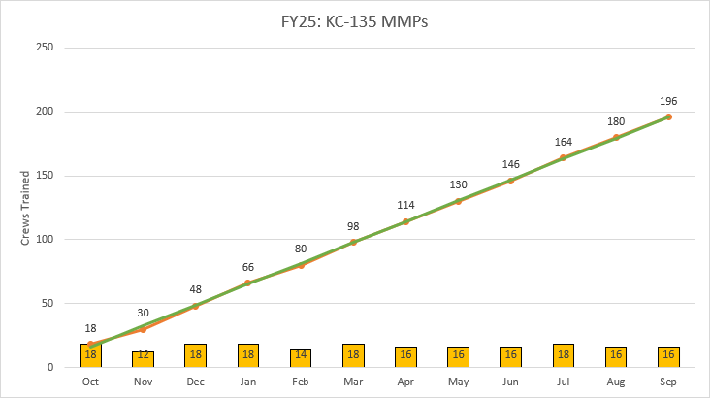
Event Management
MMP schedule on pace for CONOPS FY25 request
  C-130J reduced requirement Oct 2024 (2x MMP / month)
Always looking for ways to increase MMP utilization
  Analyzed Day of Week / Time of Day
  Moved some LX (afternoon events) to MX (mid morning)
TODAY
Notes:
KC-135 MMPs NOV 12*

Slide 11
MAF Mission Profile (MMP)
Three Main Desired Learning Objectives (DLOs):
        Blue Force Integration
        Use and understanding of Combat Communications and Brevity Terms
        Operate their aircraft in a robust, near-peer, evolving threat environment
          Adversary: Peer equipped, but not Night-1 of the war.
          Strike, Counter-Air, Escort & SEAD communications
          Tactical C2 procedures & communications
          Pre-briefed & pop-up threat reactions
          Mobile air defense, Air Defense Artillery, IR & RADAR guided threat engagements
          Rotary-wing & Fixed-wing threat engagements
          Communication jamming
          On-Call Airdrop
          Semi-prepared Runway & Tactical Landing Zone ops
What is AMC’s view on crew being prepared / acceptable to participate?
        Should Sim instructors let the crews log IMS-3 qualifications?
          Lack of Pre-mission Study (Academic viewing / Route Study / Mission Task Order understanding)
          Constant improvement & competency vs show and go exposure
          Commanders expect a level of proficiency from their crews when that bean is counted

Slide 12
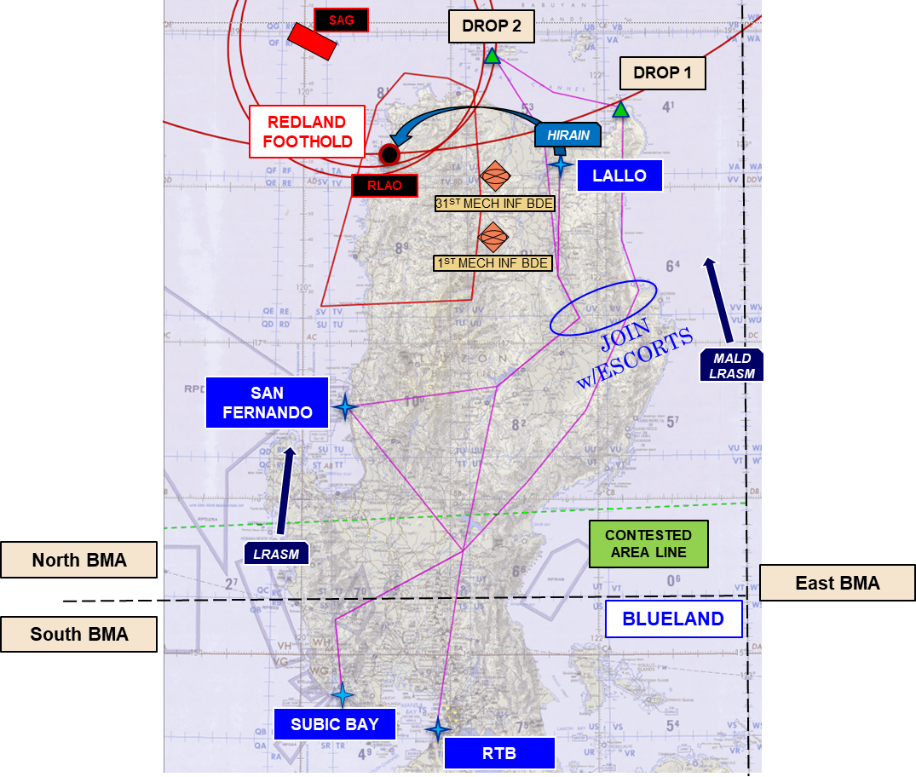
MAF Mission Profile (MMP)
Current Scenario (Korea AOR)
        No Changes
Next Scenario (Philippines AOR)
        Ready for deployment (C-17 Vis database delay)
        WEPTAC WG input
        All MDSs in the same AOR

Slide 13





FVEY Coalition Training Support
Provide Coalition Mobility Air Forces an opportunity to train together against a peer threat in a Contested or Denied Operating Environment.
Event Capstone Schedule
MMP 25-2 (19-20 Feb 25) On Track
CVG 25-2 (12-13 Mar 25) DMOC Conflict
MMP 25-3 (14-15 May 25)
CVG 25-3 (11-12 Jun 25)
MMP 25-4 (13-14 Aug 25)
CVG 25-4 (10-11 Sep 25)
“This is a great Coalition environment to practice like we would actually execute.”
Coalition training environment supporting multi-MDS (C-17/C-130/KC-135)
Execute TTP's in a contested environment
Academics and In-depth debrief w/ mission playback
Transition CVG to new scenario
Expectation of Coalition partners to take on lead planning roles

Slide 14
ATS/MDS Connectivity Status Updates

Slide 15
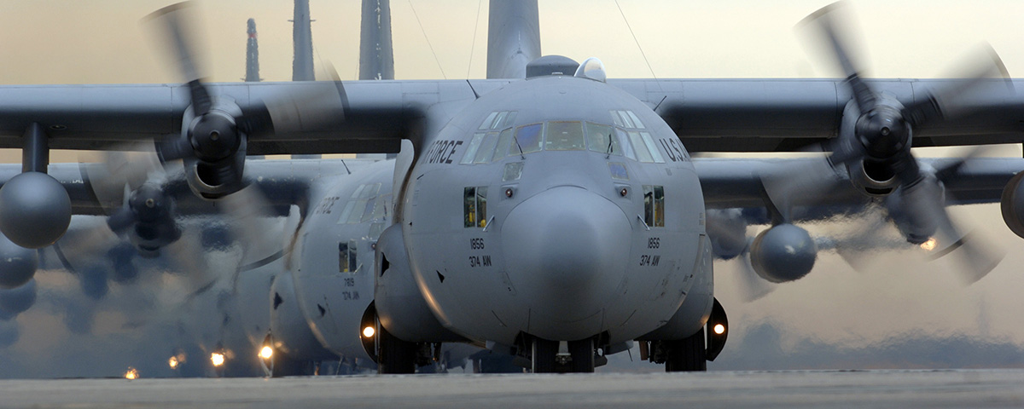
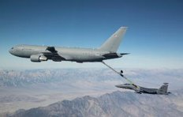
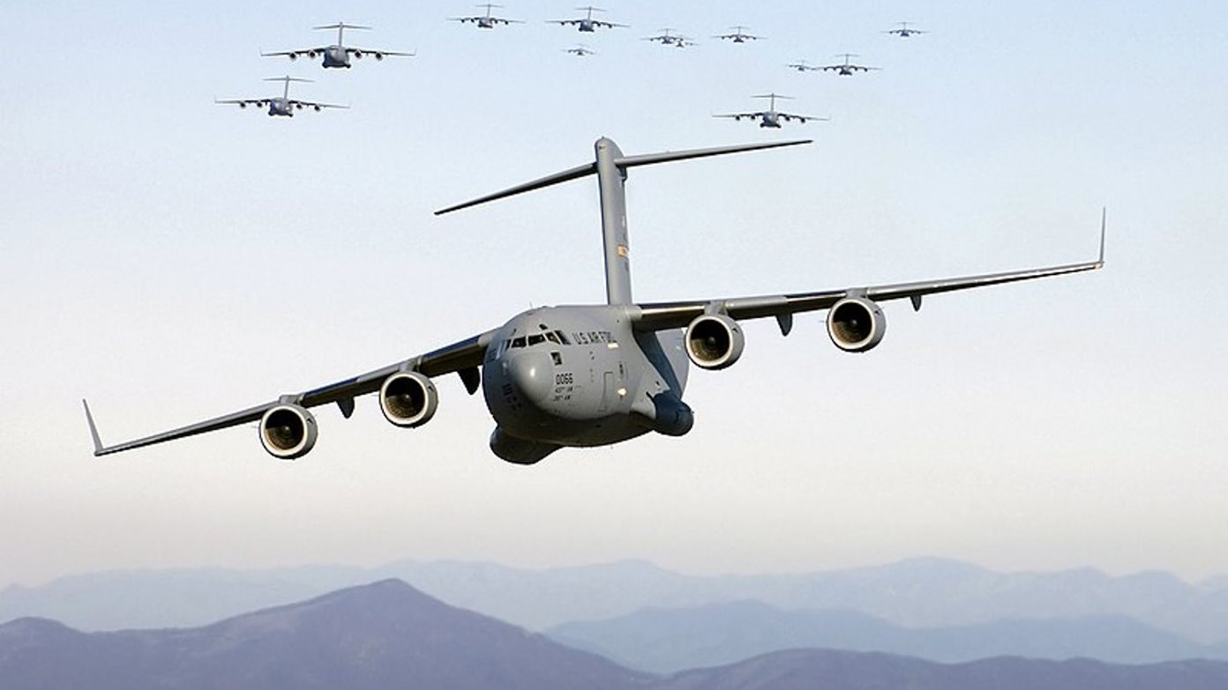
Connectivity Matrix / Flight Plan
 | FY25 |  |  |  | FY26 |  |  |  | FY27 |  |  |  | FY28
 | 1Q | 2Q | 3Q | 4Q | 1Q | 2Q | 3Q | 4Q | 1Q | 2Q | 3Q | 4Q | 1Q | 2Q | 3Q | 4Q | Cumulative
Site Survey | 1 | 1 | 1 | 0 | 0 | 1 | 1 | 0 | 0 | 0 | 0 | 0 | 0 | 0 | 0 | 0 | 14
Site Kit Install | 0 | 1 | 9 | 5 | 2 | 1 | 0 | 1 | 1 | 0 | 0 | 1 | 1 | 0 | 0 | 0 | 22
Cert & Acceptance | 1 | 1 | 3 | 8 | 5 | 2 | 1 | 0 | 1 | 1 | 0 | 0 | 1 | 1 | 0 | 0 | 25
PCA | 0 | 0 | 0 | 0 | 0 | 0 | 0 | 0 | 0 | 0 | 0 | 0 | 0 | 0 | 0 | 0 | 1
Baseline Source: MAF DMO Flight Plan (21 Aug 2025)
CUI//SP-CTI/SP-EXPT

Slide 16
O&I Integrated Site Kit Installation Schedule

Slide 17
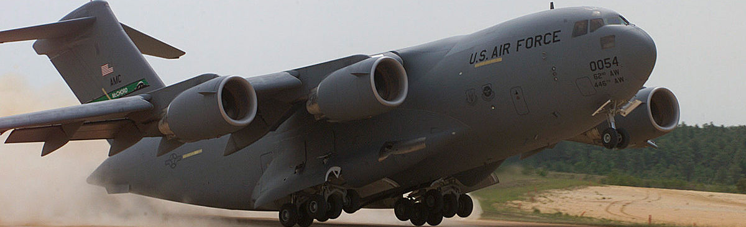
C-17
C-17

Slide 18
C-17 Connectivity Matrix
C-17 Aircrew Training Systems |  | FY25 |  |  |  |  |  |  |  |  |  |  |  | FY26 |  |  |  |  |  |  |  |  |  |  |  | Flight Plan
Sim Base | Sim Type | 1Q |  |  | 2Q |  |  | 3Q |  |  | 4Q |  |  | 1Q |  |  | 2Q |  |  | 3Q |  |  | 4Q |  |  |  | Notes
Charleston | WST/LS |  |  |  |  |  |  |  |  |  |  |  |  |  |  |  |  |  |  |  |  |  |  |  |  | -
Dover | WST/LS |  |  |  |  |  |  |  |  |  |  |  |  |  |  |  |  |  |  |  |  |  |  |  |  | -
Elmendorf | WST/LS |  |  |  |  |  |  |  |  |  |  |  |  |  |  |  |  |  |  |  |  |  |  |  |  | -
Hickam | WST/LS |  |  |  |  |  |  |  |  |  |  |  |  |  |  |  |  |  |  |  |  |  |  |  |  | -
Jackson | WST/LS |  |  |  |  |  |  |  |  |  |  |  |  |  |  |  |  |  |  |  |  |  |  |  |  | -
March | WST/LS |  |  |  |  |  |  |  |  |  |  |  |  |  |  |  |  |  |  |  |  |  |  |  |  | -
McChord | WST/LS |  |  |  |  |  |  |  |  |  |  |  |  |  |  |  |  |  |  |  |  |  |  |  |  | -
McGuire | WST/LS |  |  |  |  |  |  |  |  |  |  |  |  |  |  |  |  |  |  |  |  |  |  |  |  | -
Travis | WST/LS |  |  |  |  |  |  |  |  |  |  |  |  |  |  |  |  |  |  |  |  |  |  |  |  | -
Stewart | WST/LS |  |  |  |  |  |  |  |  |  |  |  |  |  |  |  |  |  |  |  |  |  |  |  |  | -
Martinsburg | WST/LS |  |  |  |  |  |  |  |  |  |  |  |  |  |  |  |  |  |  |  |  |  |  |  |  | -
Memphis | WST/LS |  |  |  |  |  |  |  |  |  |  |  |  |  |  |  |  |  |  |  |  |  |  |  |  | -
Wright-Patterson | WST/LS |  |  |  |  |  |  |  |  |  |  |  |  |  |  |  |  |  |  |  |  |  |  |  |  | -
Pittsburgh | WST/LS |  |  |  |  |  |  |  |  |  |  |  |  |  |  |  |  |  |  |  |  |  |  |  |  | FY24 Q3 | C&A 12-14 Feb 2025
Charlotte | WST/LS |  |  |  |  |  |  |  |  |  |  |  |  |  |  |  |  |  |  |  |  |  |  |  |  | FY24 Q3 | C&A 29-31 Jan 2025
Platform | Authorization | Expiration | Notes
C-17 ATS | ATO | 29 Mar 2025 | 1 year
C-17 Corona | ATO | 31 Dec 2026 | 2 year
Baseline Source: MAF DMO Flight Plan (21 Aug 2025)
Notes:
Intent is to discuss Installs, Site Surveys, PCAs, and planned operational status on this page.

Slide 19
C-17 DTCN Connectivity
 | Complete / Active
 | In-Progress / Working
 | Late / On Hold / Issues
Site Name | Primary VPN CCSD | SecondaryVPN CCSD | Needed By | Notes
Charleston | 7Y89 | 7A2G
Dover | 7CY9 | 7SGF
Elmendorf | XBN0 | XSN0
Hickam | KFS0 | XWN0
Jackson | 7ZGC
March | 7B0B | 7SC1 |  | Circuit activated, BGP established
McChord | 7U89 | 717L
McGuire | 79BB | 7R3G
Travis | 7V89 | 7PGF
Stewart | 7A3C
Martinsburg | 7HED
Memphis | 71RC
Wright-Patterson | 7S5B | 7JAW |  | BGP Stil down, re-attacking with Local CFP
Pittsburgh | 7ANM | 7053 |  | Degraded Rx light, DISA side cleared, Vendor side cleared; Working with Local CFP to isolate TSO Released for replacement circuit; Initial SAM released
Charlotte | 7PKT
Notes:
Intent Shows circuit status for all sites.
We will also brief any circuit outages here.

Slide 20
Qualification and Test C-17
CTP dry run – WST 19 St Louis 14-16 Jan ’25 (complete)
    CTR & TCA
Certification & Acceptance testing
  WST 28 Charlotte
    Certification 29-30 Jan ’25 (complete)
    Acceptance 31 Jan ’25 (complete)
      MATR Package in progress
  WST 27 Pittsburgh
    Certification 12-13 Feb ‘25
    Acceptance 14 Feb ‘25

Slide 21
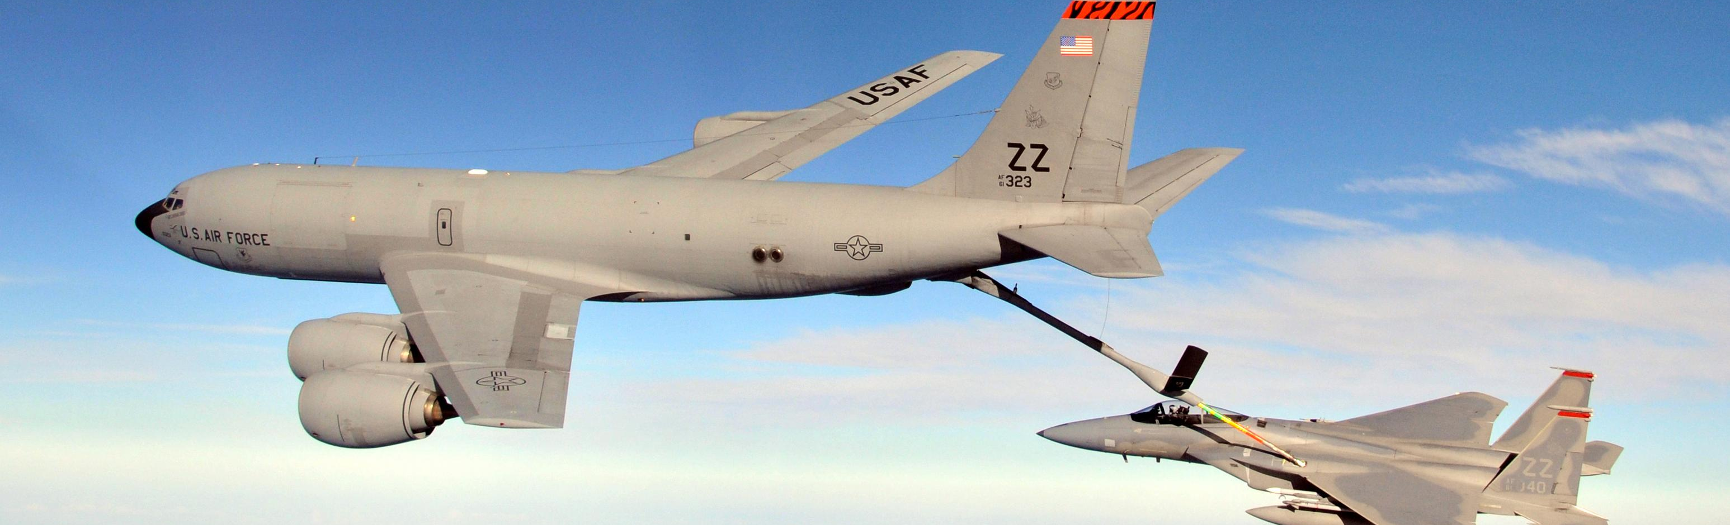
KC-135
KC-135

Slide 22
KC-135 Connectivity Matrix
KC-135 Aircrew Training Systems |  | FY25 |  |  |  |  |  |  |  |  |  |  |  | FY26 |  |  |  |  |  |  |  |  |  |  |  | Flight Plan
Sim Base | Sim Type | 1Q |  |  | 2Q |  |  | 3Q |  |  | 4Q |  |  | 1Q |  |  | 2Q |  |  | 3Q |  |  | 4Q |  |  |  | Notes
Scott | OFT/BOWST |  |  |  |  |  |  |  |  |  |  |  |  |  |  |  |  |  |  |  |  |  |  |  |  | -
Milwaukee | OFT |  |  |  |  |  |  |  |  |  |  |  |  |  |  |  |  |  |  |  |  |  |  |  |  | -
Fairchild | OFT/BOWST |  |  |  |  |  |  |  |  |  |  |  |  |  |  |  |  |  |  |  |  |  |  |  |  | -
March | OFT/BOWST |  |  |  |  |  |  |  |  |  |  |  |  |  |  |  |  |  |  |  |  |  |  |  |  | - | Move to Fairchild ~Jun '25
Grissom | OFT/BOWST |  |  |  |  |  |  |  |  |  |  |  |  |  |  |  |  |  |  |  |  |  |  |  |  | FY25 Q2 | Change to FY25 Q3 (11 Dec 24)
Meridian (Key Field) | OFT |  |  |  |  |  |  |  |  |  |  |  |  |  |  |  |  |  |  |  |  |  |  |  |  | FY25 Q3
Pittsburgh | OFT |  |  |  |  |  |  |  |  |  |  |  |  |  |  |  |  |  |  |  |  |  |  |  |  | FY25 Q2 | Change to FY25 Q4 (11 Dec 24)
Hickam | OFT |  |  |  |  |  |  |  |  |  |  |  |  |  |  |  |  |  |  |  |  |  |  |  |  | FY25 Q4
Rickenbacker | OFT |  |  |  |  |  |  |  |  |  |  |  |  |  |  |  |  |  |  |  |  |  |  |  |  | FY25 Q4
Mildenhall | OFT |  |  |  |  |  |  |  |  |  |  |  |  |  |  |  |  |  |  |  |  |  |  |  |  | FY26 Q1
Niagara Falls | OFT |  |  |  |  |  |  |  |  |  |  |  |  |  |  |  |  |  |  |  |  |  |  |  |  | FY26 Q3
Lincoln | OFT |  |  |  |  |  |  |  |  |  |  |  |  |  |  |  |  |  |  |  |  |  |  |  |  | FY28 Q2
Platform | Authorization | Expiration | Notes
KC-135 TS | ATOw/C | 03JUNE2025 | 6 Month
Baseline Source: MAF DMO Flight Plan (21 Aug 2024)

Slide 23
KC-135 DTCN Connectivity
 | Complete / Active
 | In-Progress / Working
 | Late / On Hold / Issues
Site Name | Primary VPN CCSD | Secondary VPN CCSD | Needed By | Notes
Scott | 7Y49 | 7FXH
Milwaukee | 71KF |  |  | Working CEG/EIS solution; New vendor equipment pending install for CEG.
Fairchild | 7V9D | 76WM
March | 7MGD | 7DCF
Pittsburgh | 7YQG​ |  |  | Ready for activation
Grissom | 7V2F |  |  | Ready for activation
Meridian (Key Field) | 76N0 |  | 2QFY25 | TSO Released; Working Extension
Hickam | XB12 |  | 3QFY25 | Working extension
Rickenbacker | 7DST​ |  | 3QFY25 | Commercial delivered. Pending circuit extension
Mildenhall | MPW1 |  |  | Ready for activation
Niagara Falls |  |  | 2QFY26
Lincoln |  |  | 1QFY28

Slide 24
Qualification and Test KC-135
Certification and Acceptance schedule TBD
  Pending site install schedule
  Review/Update CTP required

Slide 25
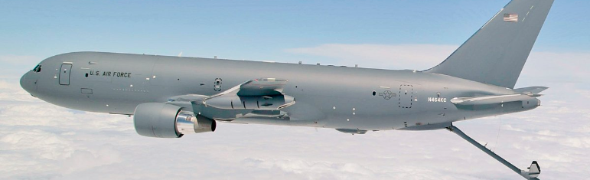
KC-46

Slide 26
KC-46 Connectivity Matrix
KC-46 Aircrew Training Systems |  | FY25 |  |  |  |  |  |  |  |  |  |  |  | FY26 |  |  |  |  |  |  |  |  |  |  |  | Flight Plan
Sim Base | Sim Type | 1Q |  |  | 2Q |  |  | 3Q |  |  | 4Q |  |  | 1Q |  |  | 2Q |  |  | 3Q |  |  | 4Q |  |  |  | Notes
McConnell | WST/BOT |  |  |  |  |  |  |  |  |  |  |  |  |  |  |  |  |  |  |  |  |  |  |  |  | FY25 Q4 | Operational likely to slide right as install get pushed
Altus (DTCN) | WST/BOT |  |  |  |  |  |  |  |  |  |  |  |  |  |  |  |  |  |  |  |  |  |  |  |  | TBD
Pease | WST/BOT |  |  |  |  |  |  |  |  |  |  |  |  |  |  |  |  |  |  |  |  |  |  |  |  | FY26 Q1
Seymour Johnson | WST/BOT |  |  |  |  |  |  |  |  |  |  |  |  |  |  |  |  |  |  |  |  |  |  |  |  | FY26 Q2
McGuire (JBMDL) | WST/BOT |  |  |  |  |  |  |  |  |  |  |  |  |  |  |  |  |  |  |  |  |  |  |  |  | FY26 Q2
Travis | WST/BOT |  |  |  |  |  |  |  |  |  |  |  |  |  |  |  |  |  |  |  |  |  |  |  |  | FY26 Q3
MacDill | WST/BOT |  |  |  |  |  |  |  |  |  |  |  |  |  |  |  |  |  |  |  |  |  |  |  |  | FY27 Q3
March | WST/BOT |  |  |  |  |  |  |  |  |  |  |  |  |  |  |  |  |  |  |  |  |  |  |  |  | TBD
Selfridge (MOB #8) | WST/BOT |  |  |  |  |  |  |  |  |  |  |  |  |  |  |  |  |  |  |  |  |  |  |  |  | TBD
MOB#7 | WST/BOT |  |  |  |  |  |  |  |  |  |  |  |  |  |  |  |  |  |  |  |  |  |  |  |  | TBD
Platform | Authorization | Expiration | Notes
KC-46 | ATO | 28 Feb 2028 | 3 Year
Baseline Source: MAF DMO Flight Plan (21 Aug 2025)

Slide 27
KC-46 DTCN Connectivity
 | Complete / Active
 | In-Progress / Working
 | Late / On Hold / Issues
Site Name | Primary VPN CCSD | Secondary VPN CCSD | Needed By | Notes
McConnell | 738T​ |  |  | Ready for activation
Altus (DTCN) |  |  | TBD
Pease | 7JCT​​ |  | 3QFY25 | Extension built to demarc at sim bldg, need to prove out with DISA
Seymour Johnson | 7LCT​ |  |  | Ready for activation
McGuire | 7CCF |  | 1QFY26 | Circuit in place; will use existing KC10 circuit: 7CCF​
Travis | 7XGC |  | 2QFY26 | Circuit in place; will use existing KC10 circuit: 7XGC
MacDill |  |  | 2QFY27
March |  |  | TBD
Selfridge |  |  | TBD
MOB #7

Slide 28
Qualification and Test KC-46
Spiral development & testing to v5.1 standard (complete)
Dry run of v5.1 CTP (complete)
  CTR (complete)
  CTP updated with lessons learned
  TCA updated
Certification & Acceptance
  Recent decision to certify sites to v5.1
Transition to v13 Standards anticipated Mar-Apr ‘25

Slide 29
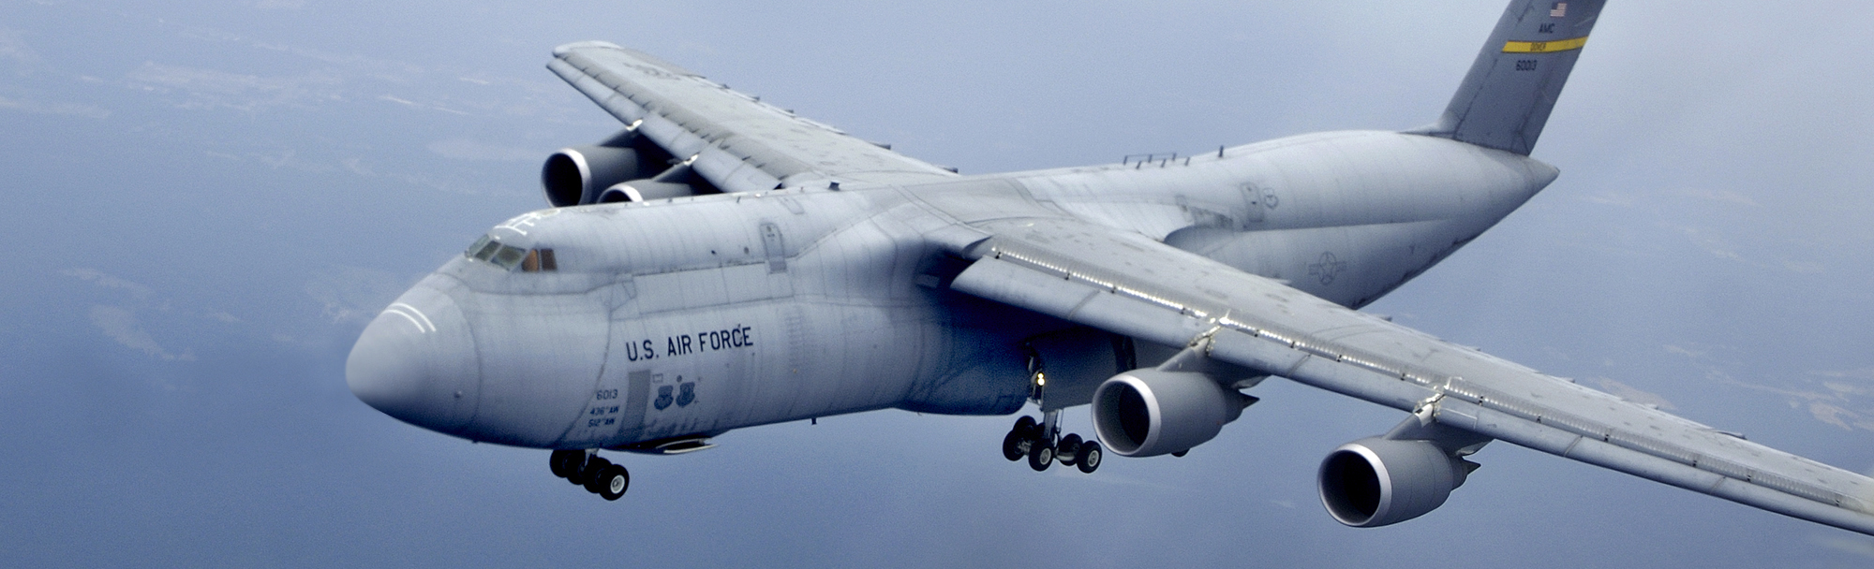
C-5
C-5

Slide 30
C-5 Connectivity Matrix
C-5 Aircrew Training Systems |  | FY25 |  |  |  |  |  |  |  |  |  |  |  | FY26 |  |  |  |  |  |  |  |  |  |  |  | Flight Plan
Sim Base | Sim Type | 1Q |  |  | 2Q |  |  | 3Q |  |  | 4Q |  |  | 1Q |  |  | 2Q |  |  | 3Q |  |  | 4Q |  |  |  | Notes
Westover | WST #6 |  |  |  |  |  |  |  |  |  |  |  |  |  |  |  |  |  |  |  |  |  |  |  |  | FY25 Q2 | Install scheduled 21 Apr 2025
Dover | WST #8 |  |  |  |  |  |  |  |  |  |  |  |  |  |  |  |  |  |  |  |  |  |  |  |  | FY25 Q2 | Install scheduled 16 Jun 2025
Lackland | WST #4 |  |  |  |  |  |  |  |  |  |  |  |  |  |  |  |  |  |  |  |  |  |  |  |  | FY25 Q3 | Install scheduled 19 May 2025
Lackland | WST #2 |  |  |  |  |  |  |  |  |  |  |  |  |  |  |  |  |  |  |  |  |  |  |  |  | FY25 Q3 | Single rack installed with WST #4 (18 Aug 2025)
Travis | WST #9 |  |  |  |  |  |  |  |  |  |  |  |  |  |  |  |  |  |  |  |  |  |  |  |  | FY26 Q1 | Install scheduled Nov 2025
Platform | Authorization | Expiration | Notes
C-5 | ATO | 18 Nov 2025 | 1 year
Baseline Source: MAF DMO Flight Plan (21 Aug 2024)

Slide 31
C-5 DTCN Connectivity
 | Complete / Active
 | In-Progress / Working
 | Late / On Hold / Issues
Site Name | Primary VPN CCSD | Secondary VPN CCSD | Needed By | Notes
Westover | 7NAS​ |  | 2QFY25 | Pending Tag/testing
Dover | 7Y4W​ |  | 2QFY25 | Base comm working Extension
Lackland (WST #4) | 7UVS |  |  | Ready for Activation
Lackland (WST #2)
Travis | 7530 |  | 4QFY25 | SNAP approved. Pending commercial delivery

Slide 32
Qualification and Test C-5
Spiral testing and CTP standards v9.1 update (complete)
Update CTP with MAF tools updates needed
Certification & Acceptance testing
  Dates TBD after scheduled site install
        Westover site install April ’25
        Lackland site install May ‘25
        Dover site install June ‘25
Standards v13 upgrade
Schedule TBD

Slide 33
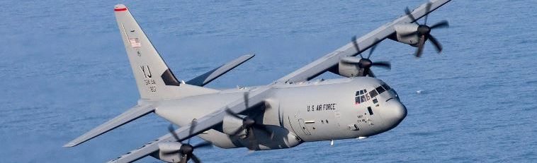
C-130J

Slide 34
C-130J Connectivity Matrix
C-130J Aircrew Training Systems |  | FY25 |  |  |  |  |  |  |  |  |  |  |  | FY26 |  |  |  |  |  |  |  |  |  |  |  | Flight Plan
Sim Base | Sim Type | 1Q |  |  | 2Q |  |  | 3Q |  |  | 4Q |  |  | 1Q |  |  | 2Q |  |  | 3Q |  |  | 4Q |  |  |  | Notes
Ramstein | WST J7 |  |  |  |  |  |  |  |  |  |  |  |  |  |  |  |  |  |  |  |  |  |  |  |  | FY23 Q3
Dyess | WST J6 |  |  |  |  |  |  |  |  |  |  |  |  |  |  |  |  |  |  |  |  |  |  |  |  | FY23 Q4
Yokota | WST J9 |  |  |  |  |  |  |  |  |  |  |  |  |  |  |  |  |  |  |  |  |  |  |  |  | FY26 Q3 | Install scheduled 11 Aug 25
Little Rock | WST J8 |  |  |  |  |  |  |  |  |  |  |  |  |  |  |  |  |  |  |  |  |  |  |  |  | FY26 Q4
Quonset (ANG) | WST 10R |  |  |  |  |  |  |  |  |  |  |  |  |  |  |  |  |  |  |  |  |  |  |  |  | FY27 Q2
Chan Isl (ANG) | WST J12R |  |  |  |  |  |  |  |  |  |  |  |  |  |  |  |  |  |  |  |  |  |  |  |  | FY28 Q3
Platform | Authorization | Expiration | Notes
C-130J MATS | ATO | 21 Nov 2026 | 2 Year
Baseline Source: MAF DMO Flight Plan (21 Aug 2024)

Slide 35
C-130J DTCN Connectivity
 | Complete / Active
 | In-Progress / Working
 | Late / On Hold / Issues
Site Name | Primary VPN CCSD | Secondary VPN CCSD | Needed By | Notes
Ramstein | MFE4
Dyess | 7V7Z
Yokota | XLW2 |  | 2QFY26 | TSO released/Pending On-base extension
Little Rock | 7RP0 |  | 3QFY26 | On-base extension COMPLETE, pending loopback test
Chan Isl (ANG) |  |  | 2QFY28
Quonset (ANG) |  |  | 1QFY27

Slide 36
Qualification and Test C-130J
TAC-F release for Yokota
C-130J limited release to CAE/LMCO – 23 Jan ’25
SIMCERT 4-5 Feb ‘25 – SPR/DC verification

Slide 37
Let’s Take a Break!
09:45 – 10:00

Slide 38
ATS/CLS (Quad Chart) Briefings

Slide 39



C-130J MATS
Contractors: Lockheed Martin RMS (Production, TSSC), Nova Technologies (O&S)
Briefer: Bob Russel (Engr, PE Systems)
Accomplishments
Upcoming Events
    2-year Type ATO for WSTs 6 & 7 (22 Nov 24 – 21 Nov 26). WSTs 8 & 9 to be added to Type after upgrade.
    MMPs: 2 per month, last was Jan 16
    WST J9 (Yokota AB JP): Requests made for TEMPEST, WLAN network, DISA circuit
    WST J8 (Little Rock AFB AR): Site survey completed
    Working DMO/NGTS mod for WST 10R (Quonset)
    Evaluated proposed routes for Philippines-based MMPs
    AMC/A3 (Tactics and Training) and AMC/A2 agreed on priorities for C-130 MAF DMO Threat List
    Next MMP: Feb 19 with WST 6 Dyess & WST 7 Ramstein
    WST J8 (Little Rock AR): mod with DMO 2Q FY26
    WST J9 (Yokota AB JP): est DISA circuit activation Jul 2025, TEMPEST approval July 2025, Site Kit Install Aug 2025, OSAT 8 Sep 2025, DD250: 28 Feb 2026, Training Load: Mar 2026, MCTP/MATP April 2026
    WST J10R (Quonset Point RI): site survey 3Q FY25 (est), mod with DMO 3Q FY27
Issues/Concerns
Special Topics
    Great teamwork on Test Tools, got TAC-F release!
    Assessing next MAF version update, needed model additions
    Will implement RWR/MWS MDT updates for INDOPACOM AOR along with new models
    Worked through visual performance issues causing Det 3 to place training restriction on DMO – multi-team effort over several trips resolved with setting on IG!
    Improved Ramstein DMO briefing/debriefing area in computer room with self-help install of soundproof partitions – more focused training!
Lead Engr: Dana Clark; PM: Matt Hartman; AMC C-130J Training Systems Mgr: Scott Hudson

Slide 40
C-17 ATS

Slide 41

KC-135 ATS
Contractor: CAE
Briefers: Eric Crawford (PM), Tyler Shumaker (PM); Chris Amend (CAE)
Accomplishments
Upcoming Events
ATO renewed – expires 3 Jun 25
  Operating System Updates Pkgs 1-2 in work
  Pkg 3 awarded, 4 to be funded end of Jan
  Host computer replacements in work/on schedule
  OFT 8 success for Aechelon IG/projector mod
SRB #14 completed 19-20 Nov (WPAFB)
SRB #15 completing 3-4 Feb (CAE Tampa)
Fairchild: 3rd sim bay MILCON BOD expected Jan 26
Mildenhall: Needs new doors and lock, no ETA
Pittsburgh: Security system installed and tested, working on open storage cert and TEMPEST package
Key Field: Planning stages for open storage
Grissom: Facility lock installed, awaiting TEMPEST cert
Rickenbacker: Still working facilities mods (door lock)
Pittsburgh OFT 9 Aechelon mods start 10 Feb – 11 Apr
Issues/Concerns
Special Topics
ATO expires 3 Jun 25; OS updates in work for mandates
Delayed MAF DMO system capability
  Funding shortfalls for facility mods/open storage
    Lack of host unit/command priority (Grissom, Hickam, Rickenbacker, Mildenhall)
  KC-46 MOB displacing KC-135 Sims to unknown / unsecure locations (MacDill, March)
Facilities/security /MILCON issues
Sim Moves/Additional Site Surveys
  OFT 7 from March to Fairchild FY26
  OFT 16 from Altus to Niagara FY26
  BOWST 8 from March to Altus storage? (SIL?)
  OFT 19 from MacDill to storage (short term), then maybe back into training at CAE facility, then potentially Lincoln FY28

Slide 42


KC-135 Boom Operating Sim Sys
Contractor: CAE, Inc./FAAC
Briefer: Anthony Casella (NGB/A3T)
Accomplishments
Upcoming Events
Completed Software v4.0 GAT
Completed Bangor BOSS #6 move in RSS
Delivered SW v3.11 TSCO
Completed new UPS integration at TSSC
BOSS SW v4.0 TSCO – Feb 2025
BOSS DMO Contract Award – (FY25 Q2/Q3)
Windows 11 GAT
Issues/Concerns
Special Topics
Facility Mods for open storage delays -Unit funding/UFR
Milwaukee BOSS circuit – AT&T
SCT Cyber Updates (RHEL – ECL)
KC-46 announcements displacing BOSS devices
  Selfridge (FY28?)
BOSS Audio Equipment Upgrades – Awaiting RFP
Rocket IG – Government owned (USARMY DEVCOM) program
Next Generation Visuals - dvLED
POCs: Ms. Tameka McCoy (WNS/PM) and
Mr. Anthony Casella (NGB/A3T)

Slide 43

KC-46 ATS
Contractor: FlightSafety (FSI-D)
Briefers: Ken Braswell (WNS); Dave Bolen (FSI-D)
Accomplishments
Upcoming Events
Proposal for v13 and NGTS under review; Apr 25 award anticipated
    HII/FSI-D Development:
  Resume SW development and v13 Spiral Tests post contract award
  SC20.0 build with v13 DMO code GAT is dependent on v13 contract award date; installs begin NLT 18 months after award, i.e., ~ Oct 26
  DTCN formal approval – requires completion of these predecessor tasks (with up to 11-month lead time):
    v13 Dev, Test and CTP acceptance, plus HII test and certification
    Security Accreditation (e.g., physical security, facility accreditation, COMSEC equip delivery/installation, facility modifications, etc.)
    DTCN Authorization to Connect approval
  Installation of Site Kits @ McConnell, Pease, SJ, JBMDL, Travis
Spiral Testing:
  Completed Spiral Testing for Standards v5.1, v6.1 (Malfunctions), and v8.0 (Adaptive Threshold)
  FSI-D reserved simulator (WST 20) for DMO development activities
Completed Site Survey at McConnell AFB KS (Nov 24)
Awarded 3-year ATO; Authorization Termination Date: 28 Feb 28
Issues/Concerns
Special Topics
  Schedule for acceptance at first site may shift right
  MAF DMO progress subject to FSI-D resource availability due to simultaneous device development
  Link-16 (Data-Link) out to 2030 on the airplane
  Development of MAF DMO version (v5.1. 6.1, and 8.0) complete, working test bugs identified. Awaiting v13 contract award
  AMC announced Selfridge ANGB, MI as KC-46 MOB 8

Slide 44

C-5 ATS
Contractor: CymSTAR
Briefers: Jaime Smith (PM); Bryan Herde (CymSTAR)
Accomplishments
Upcoming Events
The C-5 ATS was officially issued the Authorization to Operate (ATO) on 19 Nov 2024
The MAF DMO Rehost effort is complete which means DMO software is now installed on all WSTs
Lackland, Dover and Westover have security systems installed or installation in progress
DMO installations now on C-5 Master Installation Schedule for Q2-Q3 CY25
DMO installations scheduled during Q2-Q3 CY25
Continued meetings with HII and C-5 ATS site personnel to assist with site security requirements
Coordinating Test Plan Working Groups with HII, CymSTAR and applicable Det teams
Issues/Concerns
Special Topics
Lackland CE is unable to secure required funding to complete the remaining security requirements
C-5 ATS sites CORs have been tasked with a significant amount of coordination for Comm Squad, Security Forces, and CE to ensure all site requirements for DMO are met. Supporting unit availability and funding are a potential schedule risk to DMO site readiness.
Due to MAF DMO O&I transition and ATO issues, MAF DMO installation and testing is being delayed
  DMO software has been installed along with rehost installation, but there may be additional DMO bug fixes that will need to be applied later
  With the implementation of the NGTS DMO update, additional testing and bug fixes may be required

Slide 45
Action Item Review

Slide 46
NGTS

Slide 47
Break For Lunch!
12:00 – 13:00

Slide 48
Side Bars
13:00 – 14:00

Slide 49
AUGUST 2025 PMR
The next PMR is tentatively scheduled for 6-7 August 2025 at O’Fallon, IL

Slide 50
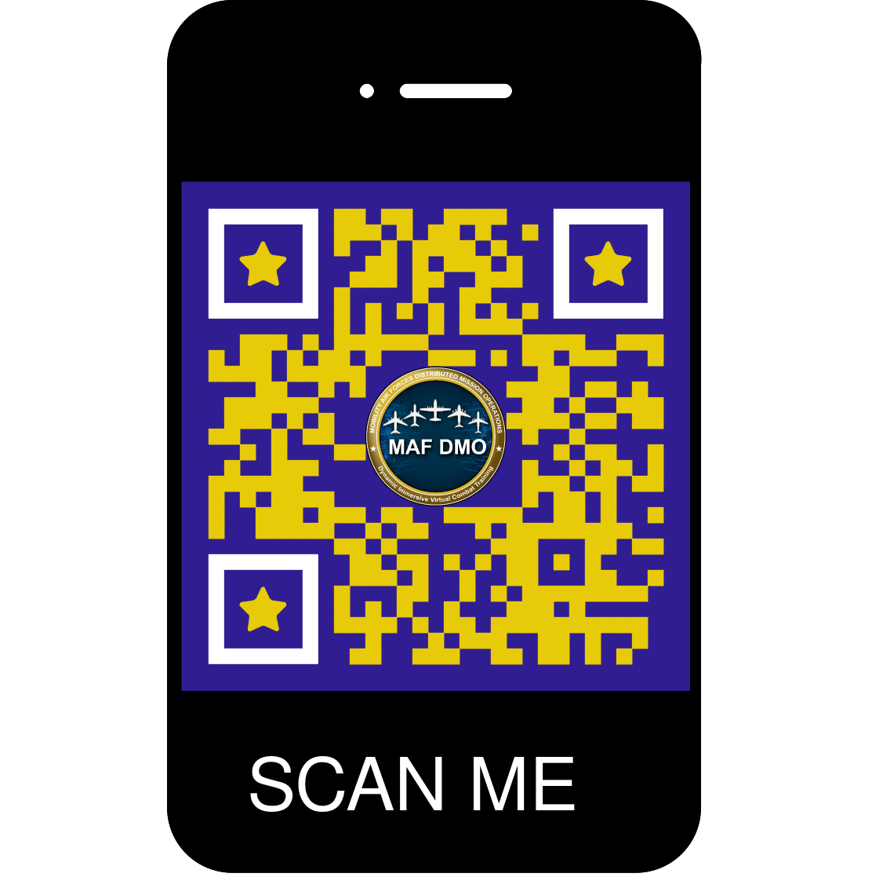
PMR Survey
The survey has the option to be anonymous.

Slide 51
MAF DMO Standards Working Group 14:00
Teams Meeting: Click here to join the meeting; or call-in +1-757-716-0190, Phone Conference ID: 122 596 131#

Slide 52
MAF DMO KC-135 MMP Viewing
16:00
2603 Challenger Tech Ct 140, Orlando, FL 32826
Visit request required – Theresa Starr (407) 569-7772, SMO Code 7BPG9, Theresa.L.Starr@hii.com

Slide 53
MAF DMO Tools Demo / Facility Tour
16:15
2603 Challenger Tech Ct 140, Orlando, FL 32826
Visit request required – Theresa Starr (407) 569-7772, SMO Code 7BPG9, Theresa.L.Starr@hii.com

Slide 54
Closing Slide.

